Slide 1
"Latency is a feature until it is an incident — budget it, then test it."
SUPPLEMENTARY · MODULE 6
Resilience and
Performance
Keep services up when dependencies fail: timeouts, retries, circuit breakers, bulkheads, caching, and the SLOs a bank will actually hold you to.
🛡️
⚡
📉
🔧
SPRING BOOT MICROSERVICES BOOTCAMP • DAY 3 • MODULE 6
Notes:
KEY TALKING POINTS
------------------
- Why resilience comes first today
In Lab 2 Transaction Service gained its first synchronous dependency: every POST waits on Account Service.
In a monolith that was an in-memory method call; now it crosses a network that can be slow, drop packets, or point at a restarting pod.
Module 6 teaches participants to treat that call as something that will fail, and to decide in advance what the caller sees, how long it waits, and how the failure is detected.
- Hands-on versus conceptual
Be explicit about scope.
Hands-on in Lab 3: the RestClient timeouts already in the Transaction starter, 2 seconds connect and 3 seconds read, plus a Resilience4j circuit breaker with a safe 503 fallback.
Awareness only: retries and exponential backoff.
Conceptual only: bulkheads and rate limiting, with no extra libraries installed.
The subtitle mentions caching, which is not part of the Day 3 outline; there is no Redis or cache work in this course.
SLOs are discussed as concepts, and the metrics behind them come on Day 4.
- The rule to carry into Lab 3
Write it on the whiteboard: never invent a successful financial outcome.
When Account Service cannot answer, Transaction Service must not assume the account is ACTIVE, must not save the transaction as if validated, and must not publish TransactionSubmitted.
It returns 503 ACCOUNT_SERVICE_UNAVAILABLE so the caller can try again later.
Every pattern in this module either supports that rule or protects resources while the rule is applied.
REAL-WORLD EXAMPLES
-------------------
- Netflix built and open-sourced Hystrix to wrap calls to dependencies with timeouts, circuit breakers, and isolated thread pools, so one failing backend did not take down the whole experience.
Hystrix is now in maintenance mode and its project page points users to Resilience4j, the library participants use in Lab 3.
USE-CASE SCENARIO
-----------------
Set the module up with one question about the capstone: a teller posts a transaction at the moment Account Service is being redeployed.
Should the transaction be rejected, held, or accepted?
Let the room argue briefly, then tell them Module 6 gives the vocabulary to answer it precisely and Lab 3 implements the answer: bounded waiting, a circuit breaker, and an honest 503 rather than an assumed approval.

Slide 2
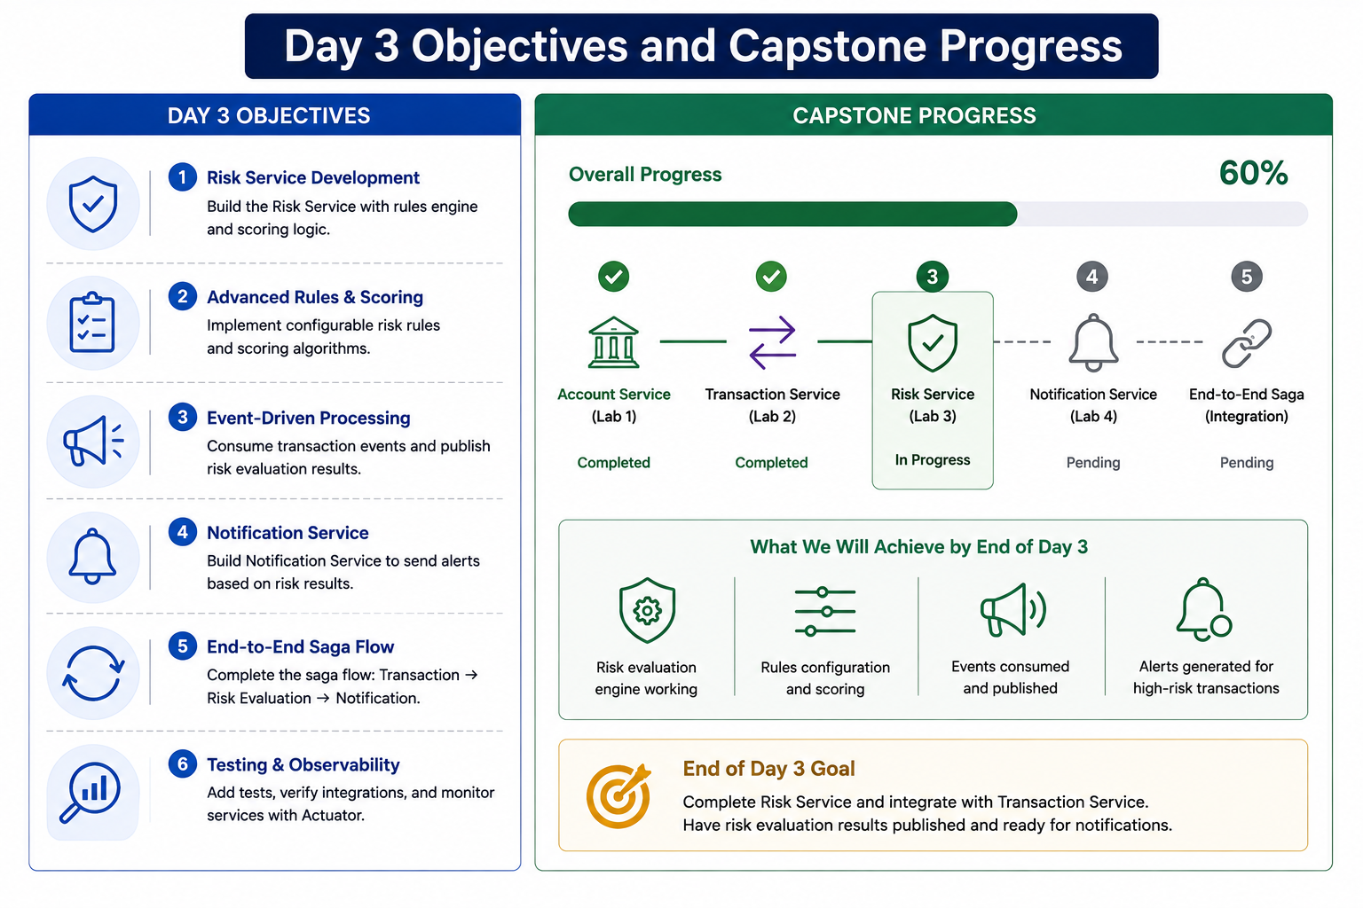
1
© 2026 by Innovation In Software Corporation
Notes:
KEY TALKING POINTS
------------------
- DAY 3 OBJECTIVES column
The six objectives shown, a Risk Service with rules and scoring, event-driven risk processing, a Notification Service, an end-to-end saga, and testing and observability, are not today's plan.
Give the correct objectives from the outline: explain failure modes, timeouts, and circuit breakers; treat bulkheads and rate limiting conceptually; secure APIs with OAuth 2.0, JWT, roles, and scopes through a Spring Security resource server; apply data minimization and log redaction; and write unit tests plus one guided integration test.
Only objective 6 overlaps, and only for testing.
- CAPSTONE PROGRESS tracker
The ticks on Account Service (Lab 1) and Transaction Service (Lab 2) are correct.
The rest is wrong.
Lab 3 does not build a Risk Service; it secures and hardens Account and Transaction Services.
Lab 4 is containers, OpenShift deployment, and CI/CD, not a Notification Service.
The capstone has exactly three services, and the third, Risk Assessment Service, is built in Lab 5 on Day 5 with OpenShift AI.
There is no Notification Service or saga step, and the 60 percent figure has no basis.
- What We Will Achieve by End of Day 3
The four tiles, a working risk engine, rules configuration, events consumed and published, and alerts for high-risk transactions, do not describe today.
Replace them verbally with the Lab 3 deliverables: 401 without a token and 403 for the wrong scope on both APIs, the caller's JWT relayed to Account Service, a circuit breaker that opens after repeated Account Service failures, a 503 fallback with no Kafka event, passing tests, and logs free of tokens and claims.
- End of Day 3 Goal box
The box says to complete Risk Service and publish risk results for notifications.
The correct goal is the outcome on the Day 3 cover: secured, resilient, tested Account and Transaction APIs with safe fallbacks and log hygiene.
Risk evaluation belongs to Day 5, where Risk Assessment Service consumes TransactionSubmitted events, calls an OpenShift AI model, and applies a deterministic policy with human-review routing.
REAL-WORLD EXAMPLES
-------------------
- Enterprise delivery teams in banks commonly harden existing services before adding new ones, because each new service adds attack surface and failure paths.
Securing and testing Account and Transaction Services before building Risk Assessment Service follows that sequence: the risk service will later consume events from a platform that already authenticates callers and fails safely.
- Out-of-date architecture diagrams are a real operational hazard.
Incident responders who trust a stale diagram may chase a service that no longer exists or miss one that does.
Correcting this slide in the room demonstrates a good habit: check diagrams against the code and runbooks before acting on them.
USE-CASE SCENARIO
-----------------
Tell the room where the capstone stands.
After Day 2, a teller can create and activate an account and post a transaction that flows through Kafka to SUBMITTED.
What the platform cannot yet do is tell a teller from an operations user, refuse a caller with no token, or respond predictably when Account Service disappears.
By the end of Lab 3, a teller token will be able to manage accounts but get 403 when posting a transaction, an ops token will post transactions successfully, and stopping Account Service will produce a fast 503 instead of an undesigned error.
Risk scoring waits until Day 5.

Slide 3
DESIGNING FOR FAILURE
Services may be unavailable, slow, or overloaded -- resilience means defining what happens next, not hoping it never occurs.
📌
ASSUME FAILURE IS NORMAL
✅
RESILIENCE BUILDING BLOCKS
• Services may be unavailable, responses may be slow, databases may reject connections
• Message brokers may back up, external APIs may throttle, infrastructure may restart
• Timeouts, retries, circuit breakers, bulkheads, rate limits
• Health checks, metrics, logging, distributed tracing, alerting
KEY TAKEAWAY Services may be unavailable, slow, or overloaded -- resilience means defining what happens next, not hoping it never occurs.
2
© 2026 by Innovation In Software Corporation
Notes:
KEY TALKING POINTS
------------------
- ASSUME FAILURE IS NORMAL
Each item is routine, not exotic.
A service is briefly unavailable during a rolling deployment.
Responses slow down under Monday-morning login traffic.
PostgreSQL rejects connections when the pool is exhausted.
A Kafka topic backs up when a consumer stalls.
An external API throttles you with 429 responses.
On OpenShift, pods are rescheduled and restarted as a matter of course.
Treating any of these as a surprise means the code only handles the happy path, which is the most common resilience mistake.
- RESILIENCE BUILDING BLOCKS
The first line holds the protective patterns: timeouts stop indefinite waiting, retries recover from brief glitches, circuit breakers stop calling a dependency that keeps failing, bulkheads isolate resource pools, and rate limits cap incoming load.
The second line holds visibility: health checks, metrics, logs, distributed tracing, and alerting tell operators the patterns are firing.
Patterns without visibility hide failures; visibility without patterns only watches the outage.
Day 3 practises the first line, and Day 4 deepens the second.
REAL-WORLD EXAMPLES
-------------------
- Netflix runs Chaos Monkey, a tool that randomly terminates production instances, so engineers must build services that tolerate losing a server at any moment.
Banks may not terminate production servers at random, but the principle transfers: rehearse failure deliberately in test environments instead of discovering behaviour during an incident.
- A mobile banking dashboard typically calls separate services for balances, recent activity, card details, and rewards.
If rewards is down, a well-designed dashboard still shows balances and transactions with a short rewards-unavailable message.
If balances are down, it must not show an invented number; it shows a clear error or a clearly labelled cached value where policy allows.
USE-CASE SCENARIO
-----------------
Walk through Transaction Service in the capstone.
It depends on Account Service over REST, its own PostgreSQL database, and Kafka.
For each, ask what happens when it fails.
If Account Service is down, Lab 3 answers with 503 ACCOUNT_SERVICE_UNAVAILABLE and no event.
If Kafka is down, the Lab 2 publisher already waits a bounded 5 seconds for the broker acknowledgement and fails the REST call rather than leaving a silent RECEIVED row.
If PostgreSQL rejects connections, the request fails and the health check reports it.
Three dependencies, three deliberate decisions: that is designing for failure.

Slide 4
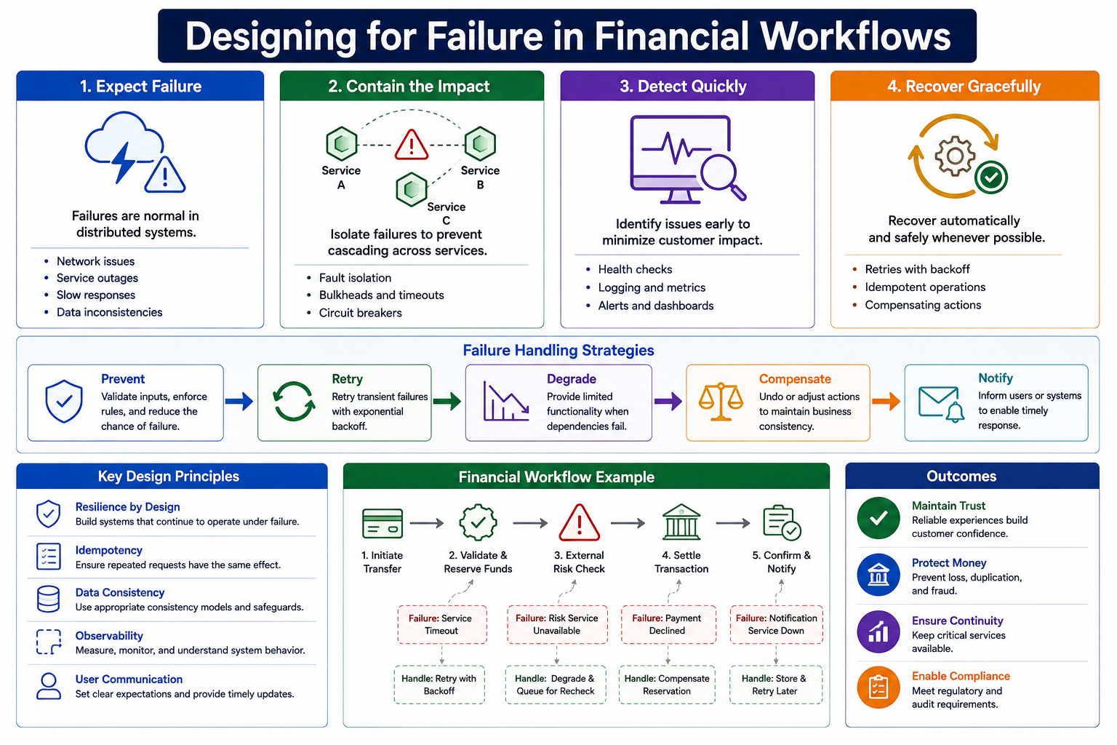
3
© 2026 by Innovation In Software Corporation
Notes:
KEY TALKING POINTS
------------------
- Four principles: Expect, Contain, Detect, Recover
Expect Failure restates the previous slides: network issues, outages, slow responses, and inconsistent data are normal.
Contain the Impact is where timeouts, bulkheads, and circuit breakers live, stopping one failing service from dragging others down.
Detect Quickly means health checks, logs, metrics, and dashboards, so operators know before customers call.
Recover Gracefully lists retries with backoff, idempotent operations, and compensating actions.
Lab 3 practises Contain directly; Detect gets deeper on Day 4.
- Failure Handling Strategies
Five strategies drawn as a chain: prevent failures with validation and rules, retry transient failures with backoff, degrade to limited functionality, compensate by undoing or adjusting actions, and notify users or systems.
Clarify that the arrows are not a mandatory pipeline; a design picks the strategies that fit each failure.
A validation error is prevented, never retried.
A dead dependency in a money flow is not degraded into an approval; Lab 3 notifies the caller with a 503 instead.
- Key Design Principles
Resilience by design means failure paths are designed alongside the happy path.
Idempotency means a repeated request has the same effect, the property that makes retries safe; Lab 2 applied it to duplicate events.
Data consistency means choosing safeguards per service, since each capstone service owns its own database.
Observability means you can see what the system is doing.
User communication means clear, timely messages, such as a 503 with a specific error code rather than a generic failure.
- Financial Workflow Example
Five steps: initiate transfer, validate and reserve funds, external risk check, settle, confirm and notify.
Each has a failure and a handler: a service timeout handled by retry with backoff, risk service unavailable handled by degrading and queueing for recheck, payment declined handled by compensating the reservation, notification service down handled by storing and retrying later.
Add one caution: retrying a timed-out reserve-funds call is safe only with an idempotency key, because the first attempt may already have reserved the money.
- Outcomes
The four outcomes explain why a bank pays for this engineering.
Maintain trust: customers who see honest, consistent behaviour keep using the channel.
Protect money: no duplicate debits and no approvals against unverified accounts.
Ensure continuity: critical services such as balances and payments stay available when non-critical ones fail.
Enable compliance: controlled, logged failure handling produces the evidence auditors expect.
Tie each outcome to a specific pattern so it does not sound like marketing.
REAL-WORLD EXAMPLES
-------------------
- Stripe's payments API accepts an Idempotency-Key header on POST requests so clients can safely retry after a network failure; a repeated request with the same key returns the original result instead of creating a second charge.
That is exactly the safeguard the retry handler under Validate and Reserve Funds depends on.
- When a card is authorised, the issuing bank typically places a hold on the funds and later settles, adjusts, or releases it if the transaction is reversed or never completes.
That hold-then-settle-or-release flow is a compensating action in everyday banking, the same idea as the Compensate Reservation handler in the diagram.
USE-CASE SCENARIO
-----------------
Map the diagram onto the capstone.
Step 1, initiate, is POST /api/v1/transactions.
Step 2, validate, is Transaction Service asking Account Service whether the account is ACTIVE.
In Lab 3 that call is contained by RestClient timeouts and a circuit breaker, and when it fails the handler is not a retry but 503 ACCOUNT_SERVICE_UNAVAILABLE with no event published.
Step 3, the risk check, arrives on Day 5, when Risk Assessment Service consumes TransactionSubmitted events asynchronously, so a risk outage delays scoring rather than blocking the POST.
Settlement and customer notification are outside the capstone's scope.

Slide 5
FAILURE MODES IN DISTRIBUTED SYSTEMS
Immediate errors, slow responses, timeouts, and partial failures each demand a different, deliberately designed response.
📌
COMMON FAILURE TYPES
• Immediate error response, slow response, timeout, partial failure
• Resource exhaustion, message processing failure, data inconsistency, configuration error
KEY TAKEAWAY Immediate errors, slow responses, timeouts, and partial failures each demand a different, deliberately designed response.
4
© 2026 by Innovation In Software Corporation
Notes:
KEY TALKING POINTS
------------------
- COMMON FAILURE TYPES
An immediate error, such as connection refused or HTTP 500, is the easy case: you know quickly.
A slow response is worse because it holds a thread.
A timeout is your decision to stop waiting, and it leaves the outcome unknown.
Partial failure means some steps succeeded and others did not.
Resource exhaustion drains threads or connection pools.
Message processing failure is a poison event, which Lab 2 routes to the dead-letter topic.
Data inconsistency means services disagree.
Configuration errors include a wrong URL or mismatched JWT secret.
REAL-WORLD EXAMPLES
-------------------
- A card authorisation that times out between acquirer and issuer is a classic unknown outcome: the terminal does not know whether a hold was placed.
Payment networks handle it with defined procedures such as reversal messages and, where issuers opt in, stand-in processing under issuer-set limits, rather than assuming approval or blindly resending.
- Configuration drift is a frequent cause of enterprise outages: a service works in test and fails after promotion because an endpoint, secret, or feature flag differs.
In Lab 3 the same shape appears if Account and Transaction Services are given different JWT secrets, so every relayed account lookup returns 401.
USE-CASE SCENARIO
-----------------
Classify the failures of the capstone's POST /api/v1/transactions.
Account Service stopped: immediate connection error.
Account Service running but stuck on a database lock: slow response, cut off by the 3 second read timeout.
Account Service returns 409 because the account is FROZEN: not a technical failure but a business rejection, which Lab 3 deliberately excludes from the circuit breaker.
Kafka acknowledgement fails after validation: a partial failure that Lab 2 turns into a failed request.
Garbage on the topic: message processing failure handled by the DLT.
Mismatched JWT secret: configuration error.
Six failures, six different correct responses.

Slide 6
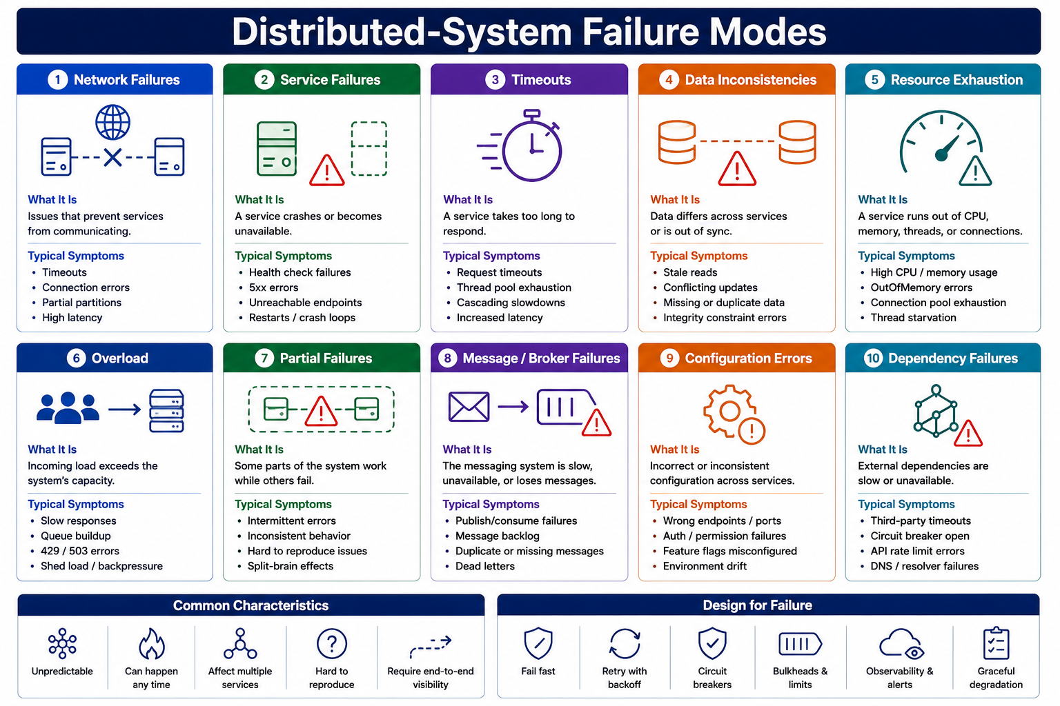
5
© 2026 by Innovation In Software Corporation
Notes:
KEY TALKING POINTS
------------------
- Top row: network, service, timeouts, data, resource exhaustion
Network failures show up as connection errors, partitions, and high latency.
Service failures show as failing health checks, 5xx errors, and crash loops, which on OpenShift appear as CrashLoopBackOff.
Timeouts show as thread pool exhaustion and cascading slowdowns.
Data inconsistencies show as stale reads, conflicting updates, and missing or duplicate data, the problem Lab 2's idempotent consumer addresses.
Resource exhaustion shows as high CPU, OutOfMemory errors, and exhausted connection pools.
Point out how often symptoms overlap between cards.
- Bottom row: overload, partial, broker, configuration, dependency
Overload means demand exceeds capacity: queues build, and 429 or 503 responses appear as the system sheds load.
Partial failures are intermittent and hard to reproduce.
Message and broker failures include backlogs, duplicate or missing messages, and dead letters, all familiar from Lab 2.
Configuration errors include wrong endpoints and ports, auth failures, and environment drift.
Dependency failures show third-party timeouts, rate-limit errors, DNS failures, and an open circuit breaker, which is also a protection working as designed.
- Common Characteristics strip
Five traits: unpredictable, can happen any time, affect multiple services, hard to reproduce, and require end-to-end visibility.
The practical consequence is that you cannot debug these from one service's log.
You need correlation IDs across services, which participants added in Lab 2, and later distributed tracing with OpenTelemetry on Day 4.
Hard to reproduce is also why failure scenarios belong in automated tests, as Module 8 and the Lab 3 circuit breaker test show.
- Design for Failure strip
Six responses: fail fast, retry with backoff, circuit breakers, bulkheads and limits, observability and alerts, and graceful degradation.
Link each to today: fail fast and circuit breakers are hands-on in Lab 3, retries are awareness, and bulkheads and limits are conceptual.
Qualify graceful degradation for money movement: degrade non-critical features, but when an account cannot be verified, the graceful outcome is a clear 503, not a guess.
REAL-WORLD EXAMPLES
-------------------
- On OpenShift and Kubernetes, a container that keeps crashing enters CrashLoopBackOff, and the kubelet waits an exponentially increasing delay, capped at five minutes, before each restart.
It illustrates two cards at once: a service failure symptom, and backoff used to avoid hammering a broken process.
- After a credential or certificate rotation, one service may pick up the new secret while another still holds the old one, so calls between them fail with authentication errors.
Operations teams in banks see this pattern during rotations: it looks like a dependency outage, but the failure mode is a configuration error.
USE-CASE SCENARIO
-----------------
Run a triage game with the capstone.
Read out a symptom and have the room name the card.
Transaction Service logs connection refused to localhost:8081: service failure.
A transaction stuck at RECEIVED: broker or consumer failure, straight from the Lab 2 troubleshooting table.
Every relayed account lookup returns 401 after one service's JWT secret changed: configuration error.
POST returns 503 instantly without any call reaching Account Service: dependency failure with the circuit breaker open.
The same event arrives twice: a broker duplicate handled by the idempotent consumer.
Each answer points to a different fix.

Slide 7
NETWORK LATENCY AND UNRELIABLE COMMUNICATION · CASCADING FAILURE
📌
WHY NETWORK CALLS ARE DIFFERENT
⚠️
HOW CASCADING FAILURE SPREADS
• Latency, jitter, and packet loss are inherent to any network hop
• A remote call can fail in ways a local call simply cannot: DNS failure, connection reset, partial response
• A slow or failing dependency ties up threads, connections, and memory in the caller
• The caller becomes unhealthy too, and the failure propagates to ITS callers
• Timeouts, circuit breakers, and bulkheads exist specifically to stop this chain
KEY TAKEAWAY In a monolith, calls happen in memory; in microservices, every call crosses a network that can delay, drop, or corrupt it. • A slow Fraud Detection Service can exhaust Transaction Service's threads, which then can't serve any request -- healthy or not.
6
© 2026 by Innovation In Software Corporation
Notes:
TOPIC 1 OF 2: Network Latency and Unreliable Communication
------------------------------------------
KEY TALKING POINTS
------------------
- WHY NETWORK CALLS ARE DIFFERENT
Latency is how long a call takes; jitter is how much that time varies, which is why averages hide trouble and teams watch 95th and 99th percentiles.
Packet loss forces retransmission and adds delay.
Then come failures a local call never has: DNS cannot resolve the service name, the connection is reset mid-request, or only part of the response arrives.
The worst consequence is ambiguity, because the caller cannot tell whether the remote side did the work.
That is why remote calls need timeouts and idempotency.
REAL-WORLD EXAMPLES
-------------------
- When Transaction Service moves to OpenShift on Day 4, it will reach Account Service through a Kubernetes Service name resolved by cluster DNS.
A mistyped service name or a DNS problem fails the call before any HTTP is sent, a failure mode that did not exist when both modules lived in one JVM.
- The fallacies of distributed computing, a list attributed to engineers at Sun Microsystems, begin with the assumptions that the network is reliable and latency is zero.
They still describe exactly what breaks when a monolith's method calls become HTTP calls between services.
USE-CASE SCENARIO
-----------------
Tell the story of the first Lab 2 integration.
On a laptop, Transaction Service calls Account Service on localhost and the round trip feels instant, so it is tempting to treat the account check like a local method call.
Now picture both services on OpenShift in separate pods, possibly on different nodes, while Account Service is being redeployed.
The same line of code can now hang, fail to resolve, or get a connection reset.
Lab 3 does not change that line; it bounds it with timeouts and wraps it in a circuit breaker so each of those outcomes becomes a defined response.
TOPIC 2 OF 2: Cascading Failure
-------------------------------
KEY TALKING POINTS
------------------
- HOW CASCADING FAILURE SPREADS
Slowness is more dangerous than a crash.
A crashed dependency refuses connections quickly; a slow one holds each caller thread until the read completes.
Spring MVC serves requests from a bounded Tomcat thread pool, so enough stuck calls leave no threads for any request, including ones that never touch the slow dependency.
The caller now looks down to its own clients, and the failure moves upstream.
Timeouts cap each wait, circuit breakers stop sending calls, and bulkheads fence off resource pools.
REAL-WORLD EXAMPLES
-------------------
- Google's Site Reliability Engineering book has a chapter on cascading failures describing how overload on some servers shifts traffic to others, which then overload in turn.
Its recommended defences include load shedding, limiting retries, and propagating request deadlines, the same family of controls as this slide.
- In online banking, a slow statement-download service called from the same thread pool as balance enquiries can make the whole app appear down even though balances are healthy.
Giving the statement calls their own timeout and concurrency limit keeps the critical balance path available.
USE-CASE SCENARIO
-----------------
Map the chain onto the capstone.
The slide's Fraud Detection Service is illustrative; in Lab 3 the real synchronous dependency is Account Service.
Suppose Account Service's database is overloaded and every account lookup takes 20 seconds.
Each POST /api/v1/transactions holds a Transaction Service thread while it waits.
Without a read timeout, the pool fills, simple transaction lookups start queuing, and the teller application calling Transaction Service times out too.
With the 3 second read timeout and a circuit breaker that opens after repeated failures, threads are released quickly and callers receive a fast 503 instead.

Slide 8
TIMEOUT PATTERN
Without a timeout, slow dependencies can silently consume threads, memory, and connection pools until the caller itself becomes unhealthy.
📌
WHERE TIMEOUTS APPLY
🏦
BANKING EXAMPLE
• HTTP calls, database queries, message broker operations, external API calls
• File operations and cache operations also need timeouts
• Transaction Service -> Account Service: waits up to 2 seconds
• If no response, timeout handling takes over -- Transaction Service does not wait indefinitely
KEY TAKEAWAY Without a timeout, slow dependencies can silently consume threads, memory, and connection pools until the caller itself becomes unhealthy.
7
© 2026 by Innovation In Software Corporation
Notes:
KEY TALKING POINTS
------------------
- WHERE TIMEOUTS APPLY
Every operation that leaves the JVM needs a bound.
HTTP calls use connect and read timeouts.
Database queries can have query timeouts, and the connection pool has its own limit on waiting for a free connection.
Broker operations matter too: Lab 2's publisher waits at most 5 seconds for the Kafka acknowledgement.
External APIs such as credit bureaus need their own limits.
File and cache operations are easy to forget; a hung network share or unresponsive cache blocks a thread as effectively as a slow service.
- BANKING EXAMPLE
Correct the number as you teach it.
The slide says Transaction Service waits up to 2 seconds for Account Service.
In the Lab 3 starter, RestClientConfig sets two separate limits: 2 seconds to establish the connection and 3 seconds to read the response.
A connection timeout catches an unreachable host; a read timeout catches a service that accepted the connection but is stuck.
When either fires in Lab 3, the circuit breaker fallback converts it into 503 ACCOUNT_SERVICE_UNAVAILABLE, so Transaction Service never waits indefinitely.
REAL-WORLD EXAMPLES
-------------------
- Card authorisation requests pass through acquirer, network, and issuer systems, each with its own response time limit.
When the issuer does not answer in time, the network follows a defined path such as stand-in processing or a decline, and the acquirer can send a reversal.
Timeouts are built into the payment rails themselves.
- Spring Boot applications use HikariCP as the default connection pool, and its connectionTimeout setting controls how long a request waits for a free database connection before failing.
When slow queries hold connections, that bound is what stops every web thread from queuing indefinitely behind the pool.
USE-CASE SCENARIO
-----------------
Contrast the two Lab 3 timeouts with a thought experiment.
First, stop Account Service entirely: the connection is refused almost instantly, well inside the 2 second connect timeout, so Transaction Service learns quickly.
Second, imagine Account Service is running but a database lock makes the account query hang: the connection succeeds, and now the 3 second read timeout is what rescues the Transaction Service thread.
Without that read timeout, each POST /api/v1/transactions could hold a thread for as long as the lock lasts.
Ask the room which case is more dangerous, and why.

Slide 9
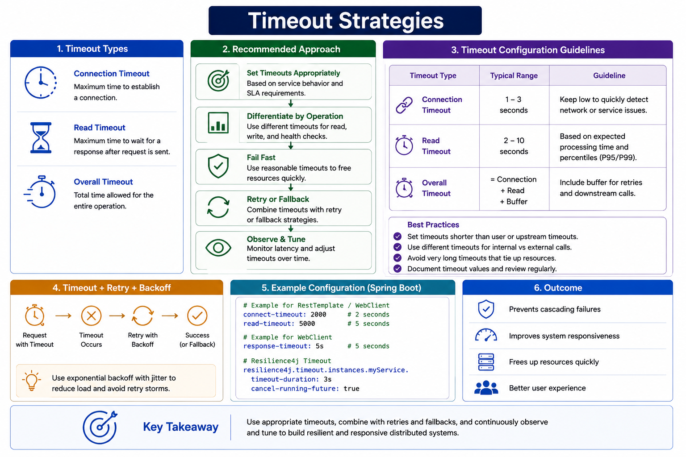
8
© 2026 by Innovation In Software Corporation
Notes:
KEY TALKING POINTS
------------------
- 1. Timeout Types
Connection timeout is the maximum time to establish a connection; read timeout is the maximum wait for response data after the request is sent; overall timeout bounds the entire operation, including any retries.
Map the first two to the Lab 3 RestClient: 2 seconds connect and 3 seconds read.
The overall timeout matters once retries appear, because three attempts with a 3 second read timeout can keep a caller waiting far longer than any single timeout suggests.
- 2. Recommended Approach
Five steps.
Set timeouts from service behaviour and SLA requirements rather than framework defaults.
Differentiate by operation: a health check should be much shorter than a report export.
Fail fast so threads are freed quickly.
Combine timeouts with retry or fallback, because a timeout alone just converts a hang into an exception.
Observe and tune: watch the latency distribution and revisit values when it changes.
Day 4's metrics are what make that last step evidence-based.
- 3. Timeout Configuration Guidelines
The table suggests 1 to 3 seconds for connection timeouts, 2 to 10 seconds for read timeouts based on 95th and 99th percentile latency, and an overall timeout of connection plus read plus a buffer.
Treat the ranges as starting points, not rules; an internal account lookup should usually sit at the low end.
The best practices are sound: be shorter than upstream timeouts, separate internal from external calls, avoid very long timeouts, and document and review the values.
- 4. Timeout + Retry + Backoff
The flow runs request with timeout, timeout occurs, retry with backoff, then success or fallback, and the tip recommends exponential backoff with jitter to avoid retry storms.
In MD287 this is awareness.
Lab 3 adds no retry around Account Service: its path is timeout, recorded failure, circuit breaker, and a 503 fallback.
The account lookup is a read, so retrying would not duplicate data, but it would multiply wait time and add load to a struggling service.
- 5. Example Configuration (Spring Boot)
Correct this snippet before anyone copies it.
The keys connect-timeout, read-timeout, and response-timeout shown for RestTemplate and WebClient are illustrative, not standard Spring Boot properties that configure those clients by themselves.
There is no resilience4j.timeout namespace: the Resilience4j time limiter lives under resilience4j.timelimiter, uses timeout-duration and cancel-running-future, and applies to asynchronous calls.
Lab 3 sets its timeouts in Java code in RestClientConfig, 2 seconds connect and 3 seconds read, not the 5 second read shown.
- 6. Outcome and Key Takeaway
Four outcomes: prevents cascading failures, improves responsiveness, frees resources quickly, and improves user experience.
The takeaway bar ties them together: use appropriate timeouts, combine them with retries and fallbacks, and keep observing and tuning.
Add the banking qualifier: a better user experience means a fast, honest answer.
A teller told the service is temporarily unavailable within seconds is better served than one watching a spinner, and far better served than one whose transaction was posted against an unverified account.
REAL-WORLD EXAMPLES
-------------------
- The AWS Builders' Library article Timeouts, retries, and backoff with jitter describes choosing a timeout from the measured latency percentiles of the downstream service rather than guessing, and warns that retries multiply load during outages.
It is a well-known public reference that matches panels 2 and 3 of this diagram.
- A bank's mobile app can reasonably give a balance lookup a budget of a second or two while allowing a statement PDF export much longer, because customers expect exports to take time.
A single shared timeout would either cut off legitimate exports or let balance calls hang, which is the Differentiate by Operation step in practice.
USE-CASE SCENARIO
-----------------
Have the class reason about tuning the capstone's Account Service timeout.
Suppose Day 4 dashboards show account lookups normally completing well under half a second, with rare outliers near one second.
The Lab 3 read timeout of 3 seconds leaves headroom for those outliers while still freeing threads long before a teller gives up.
If the dashboards later show outliers creeping toward three seconds, the right first response is to investigate Account Service, not simply raise the timeout.
Raising it would hide the problem and reintroduce the risk of thread exhaustion.

Slide 10
CHOOSING EFFECTIVE TIMEOUT VALUES · RETRY PATTERN · EXPONENTIAL BACKOFF AND JITTER
📌
TIMEOUT BUDGET EXAMPLE
✅
SELECTION FACTORS
✅
RETRYABLE FAILURES
• Total budget: 3000 ms
• Customer lookup: 500 ms, Account validation: 700 ms, Fraud check: 800 ms
• Remaining budget covers response processing
• Business requirements, expected latency, user experience, downstream behavior, SLA targets
• Short timeouts fail fast but risk false rejects; long timeouts tie up resources
• Temporary network error, HTTP 503, HTTP 429 with retry-after guidance
• Short database connection interruption, temporary broker disconnect
❌
NON-RETRYABLE FAILURES
📌
BACKOFF PROGRESSION EXAMPLE
✅
WHY JITTER MATTERS
• Validation errors, authentication failure, authorization failure
• Resource not found, business rule rejection
• Attempt 1 fails -> wait 200 ms
• Attempt 2 fails -> wait 500 ms
• Attempt 3 fails -> stop and report failure
• Adds randomness to retry delays so many instances don't retry in lockstep
• Prevents a coordinated retry spike from overwhelming a recovering dependency
KEY TAKEAWAY If the customer-facing API must respond in 3 seconds, downstream timeouts must be carved out of that same 3-second budget. • Retrying a temporary email provider outage is safe; retrying a money transfer without idempotency can create duplicate transactions. • Without jitter, many service instances retrying on the exact same schedule can create a synchronized retry storm that re-overloads the dependency.
9
© 2026 by Innovation In Software Corporation
Notes:
TOPIC 1 OF 3: Choosing Effective Timeout Values
------------------------------------------
KEY TALKING POINTS
------------------
- TIMEOUT BUDGET EXAMPLE
Add the numbers aloud: 500 plus 700 plus 800 is 2000 ms, leaving about 1000 ms for the service's own work and the response, assuming the calls run one after another.
The point is that no downstream call may be given the full 3 seconds, because the customer's clock is already running.
If calls run in parallel, the slowest call rather than the sum sets the cost.
Retries also consume the same budget, so any retry must fit inside the envelope.
- SELECTION FACTORS
Business requirements come first: a card authorisation has a far tighter window than an overnight report.
Expected latency means measured percentiles, not hopes.
User experience asks how long a person will wait before tapping again, which can itself create duplicate submissions.
Downstream behaviour asks whether the dependency is internal, external, or rate limited.
SLA targets set the outer bound.
Short timeouts fail fast but reject requests that were merely a little slow; long timeouts save those requests but tie up threads and connections.
REAL-WORLD EXAMPLES
-------------------
- Google's SRE guidance recommends deadline propagation: when a request arrives with a deadline, each downstream call receives only the time remaining rather than a fresh full timeout.
gRPC supports deadlines that travel with the call, a concrete implementation of the timeout budget shown on this slide.
- In online bill payment, a customer who waits too long often presses Pay again.
A budget that is too generous therefore does not only hold threads; it can generate a second submission, which is why payment endpoints pair realistic timeouts with idempotency keys.
USE-CASE SCENARIO
-----------------
Give the room a capstone budget exercise.
A branch teller application must show a transaction result within 3 seconds.
The request goes to Transaction Service, which validates the account with Account Service, writes to PostgreSQL, and waits for the Kafka acknowledgement.
Ask participants to allocate milliseconds to each step.
Then reveal the lab's actual limits: 2 seconds to connect and 3 seconds to read from Account Service, and up to 5 seconds for the Kafka acknowledgement.
Each is sensible alone, yet together they can exceed the 3 second target, which is why failing fast during an outage matters so much.
TOPIC 2 OF 3: Retry Pattern
---------------------------
KEY TALKING POINTS
------------------
- RETRYABLE FAILURES
All five share one property: the identical request might succeed a moment later without anything changing.
A network blip or pod restart passes in seconds.
HTTP 503 means temporarily unable to serve.
HTTP 429 means slow down, and its Retry-After header says when; honour it rather than inventing a delay.
A brief database or Kafka disconnect usually recovers on reconnection; Lab 2's consumer retries a failed message twice before sending it to the dead-letter topic.
Retryable still means a limited number of attempts.
- NON-RETRYABLE FAILURES
These fail identically every time, so retrying only adds load and delay.
A 400 validation error will not fix itself.
A 401 or 403 means the token is missing, invalid, or lacks a scope; in Lab 3, resending the same token cannot help.
A 404 means the account does not exist.
A business rejection, such as Account Service returning 409 because the account is FROZEN, is a correct answer rather than a fault; Lab 3 even excludes it from the circuit breaker's failure statistics.
REAL-WORLD EXAMPLES
-------------------
- Email and SMS providers commonly return temporary errors or rate-limit responses during traffic peaks, so notification systems retry those sends with backoff.
When the same provider reports an invalid recipient address, the failure is permanent, and a well-built sender stops immediately and records it instead of retrying.
- Stripe documents idempotency keys so a client whose POST timed out can safely resend the same request; the server returns the original result rather than charging twice.
Without that key, retrying a charge after a timeout risks a duplicate payment, the exact danger named in this slide's subtitle.
USE-CASE SCENARIO
-----------------
Run a quick retry-or-not round with capstone flavour, and have the room call out each answer.
An email provider used for customer notifications returns 503: retry with backoff.
POST /api/v1/transactions returns 400 because a required field is missing: do not retry.
A teller token receives 403 from the transaction API: do not retry, the scope is wrong.
A client's POST to Transaction Service timed out and it does not know whether the transaction was stored: do not blindly retry; check first or rely on an idempotency key.
The Kafka broker briefly disconnects: retry.
Spend the longest on the timeout case.
TOPIC 3 OF 3: Exponential Backoff and Jitter
------------------------------------------
KEY TALKING POINTS
------------------
- BACKOFF PROGRESSION EXAMPLE
Three things to notice.
The wait grows between attempts, giving the dependency time to recover; strict exponential backoff would double each time, so 200 then 500 ms is better described as an increasing schedule.
There is a hard stop after the third attempt, so the caller reports failure instead of looping.
And the stop is visible: the failure is reported and should be logged and counted.
In Resilience4j retry configuration, max-attempts includes the first call, so this example corresponds to max-attempts of 3.
- WHY JITTER MATTERS
Picture six Transaction Service pods that all lose Account Service at the same moment.
With identical backoff, all six retry at 200 ms and again at 500 ms, producing synchronised spikes just as Account Service tries to recover.
Jitter adds a random offset to each delay so retries spread out over time.
The failure it prevents is often called a thundering herd or retry storm.
Resilience4j supports a randomised wait for retries, and the AWS SDKs apply jitter to their retries.
REAL-WORLD EXAMPLES
-------------------
- The AWS Architecture Blog post Exponential Backoff and Jitter compared retry strategies in simulation and showed that adding jitter substantially reduced the work clients generated under contention.
AWS SDKs retry throttling and transient errors with exponential backoff and jitter, so many AWS customers use this pattern without writing it themselves.
- Mobile banking apps face a herd problem when an outage ends: many phones that failed to refresh try again at once.
Spreading reconnection with randomised backoff, in the app or at the API gateway, keeps the recovering login and balance services from being flattened by a synchronised return.
USE-CASE SCENARIO
-----------------
Tell a Day 4 recovery story for the capstone, when Transaction Service runs as several pods on OpenShift.
Account Service is redeployed and briefly unavailable.
If every Transaction Service pod retried the account lookup on a fixed schedule, all of them would hit the new Account Service pod in the same instants while it starts up, possibly failing its readiness checks and extending the outage.
Jittered backoff would spread those calls out.
Then note that Lab 3 deliberately adds no retries; the circuit breaker's open wait and limited half-open test calls play the protective role instead.

Slide 11
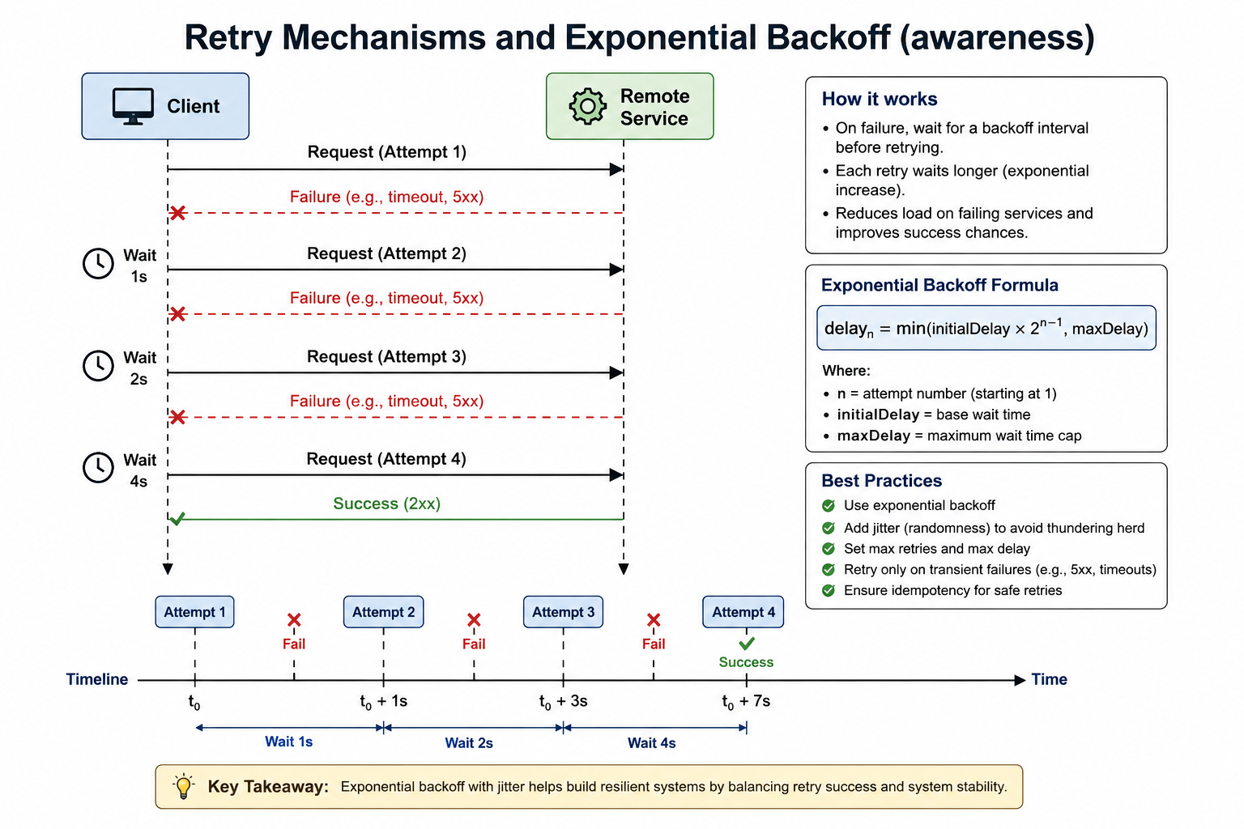
10
© 2026 by Innovation In Software Corporation
Notes:
KEY TALKING POINTS
------------------
- Client and Remote Service sequence
Read the arrows top to bottom.
Attempt 1 fails with a timeout or 5xx, and the client waits 1 second.
Attempt 2 fails, and the wait doubles to 2 seconds.
Attempt 3 fails, and the wait doubles to 4 seconds.
Attempt 4 returns a 2xx success.
Emphasise that the client owns this schedule, not the service.
Add a caution the diagram omits: if an attempt timed out on a POST, the remote side may already have processed it, so retries are only safe for idempotent operations.
- Timeline
The timeline makes the cost visible: success arrives at t0 plus 7 seconds, and that assumes every failure returns instantly.
With the Lab 3 read timeout of 3 seconds, three timed-out attempts alone would add 9 seconds on top of the waits.
Compare that with a teller whose whole budget is about 3 seconds, and it is clear why long retry chains inside a user request are a problem.
Note also that the drawn waits contain no jitter, although the best practices recommend it.
- How it works and Exponential Backoff Formula
The formula says the delay before retry n is initialDelay multiplied by two to the power of n minus 1, capped at maxDelay.
With an initialDelay of 1 second the delays are 1, 2, 4, then 8 seconds and so on until the cap.
The cap matters because unbounded doubling quickly produces waits of minutes.
The how-it-works box states the goal: waiting longer each time reduces load on a failing service and improves the chance that the next attempt lands after recovery.
- Best Practices and Key Takeaway
Five practices: use exponential backoff, add jitter to avoid the thundering herd, set both maximum retries and maximum delay, retry only transient failures, and ensure idempotency.
Refine the fourth: the diagram lists 5xx and timeouts, but a 500 caused by a bug is not transient, and a timeout on a non-idempotent call is risky; 503 and 429 are clearer retry signals.
The takeaway balances retry success against system stability, which is why MD287 teaches retries as awareness.
REAL-WORLD EXAMPLES
-------------------
- Exponential backoff is decades old in networking.
Classic Ethernet used binary exponential backoff after collisions, and TCP doubles its retransmission timeout after repeated losses.
Application libraries such as Resilience4j bring the same idea to service-to-service calls.
- OpenShift and Kubernetes apply it to failing containers: a pod that keeps crashing is restarted with an exponentially increasing delay capped at five minutes, reported as CrashLoopBackOff.
Participants may see this status on Day 4 if a service cannot reach its database at startup.
USE-CASE SCENARIO
-----------------
Place the diagram in the capstone and ask whether it belongs there.
Transaction Service could wrap the Account Service lookup with this exact four-attempt schedule.
The lookup is a GET, so duplication is not the concern.
But during an Account Service outage a teller would wait the 7 seconds of backoff plus up to 3 seconds for each timed-out attempt, and every in-flight transaction would multiply load on Account Service.
Lab 3 chooses differently: one attempt bounded by the RestClient timeouts, a circuit breaker that stops calls during an outage, and a 503 so the client decides when to try again.

Slide 12
WHEN RETRIES MAKE FAILURES WORSE · CIRCUIT BREAKER PATTERN
⚠️
HOW RETRIES BACKFIRE
📌
WHY CIRCUIT BREAKERS HELP
🏦
BANKING EXAMPLE
• Retrying every exception, including non-transient ones
• No maximum retry limit, or retrying non-idempotent operations
• Combining long timeouts with multiple retries multiplies total wait time
• Prevent cascading failures, thread exhaustion, and excessive retries
• Stop slow request buildup and avoid overloading an already-failing service
• If Fraud Detection Service fails repeatedly, the circuit opens
• Transactions may be rejected, marked pending review, or handled under a fallback policy
KEY TAKEAWAY Retrying every exception, with no limit, from many instances at once, amplifies load on a dependency that's already struggling to keep up. • When failures exceed a threshold, the circuit opens and blocks calls immediately -- protecting both the caller's resources and the struggling dependency.
11
© 2026 by Innovation In Software Corporation
Notes:
TOPIC 1 OF 2: When Retries Make Failures Worse
------------------------------------------
KEY TALKING POINTS
------------------
- HOW RETRIES BACKFIRE
Retrying every exception wastes calls on failures that cannot succeed, such as a 403 or a validation error.
No limit means a dead dependency receives endless traffic from every caller.
Retrying non-idempotent operations, such as creating a transaction, risks duplicates.
Long timeouts multiplied by retries destroy latency: three attempts with a 3 second read timeout can hold a thread for over 9 seconds.
Layers compound it: if three layers each make three attempts, the bottom service can receive twenty-seven calls for one user click.
REAL-WORLD EXAMPLES
-------------------
- Google's SRE book discusses retry amplification in its chapter on cascading failures and recommends limiting retries per request, using a server-wide retry budget, and avoiding retries at multiple layers of the stack.
The twenty-seven-calls arithmetic on this slide is the reason those rules exist.
- In a payments platform, an API gateway, a payment service, and a core banking adapter might each retry independently.
If the core system slows during heavy end-of-day processing, those stacked retries multiply traffic at exactly the moment it has the least spare capacity, stretching a slowdown into an outage.
USE-CASE SCENARIO
-----------------
Describe a well-meaning change to the capstone.
A developer sees occasional Account Service errors and adds retries in three places: the teller application retries Transaction Service three times, Transaction Service retries Account Service three times, and Account Service retries its database query.
One afternoon Account Service's database slows.
Each teller click now becomes up to nine account lookups and even more queries, each waiting on long timeouts.
Account Service collapses under the extra load and Transaction Service threads fill.
The Lab 3 design avoids this: no stacked retries, and a circuit breaker that stops calls once failures pile up.
TOPIC 2 OF 2: Circuit Breaker Pattern
-------------------------------------
KEY TALKING POINTS
------------------
- WHY CIRCUIT BREAKERS HELP
A timeout limits the damage of one slow call; a circuit breaker notices that calls keep failing and stops making them.
That prevents cascading failure and thread exhaustion because no threads wait on a dependency known to be failing.
It curbs excessive retries because callers get an immediate answer.
It stops slow request buildup and gives the failing service room to recover instead of being hammered.
It also produces a clear operational signal: a state change that operators can alert on.
- BANKING EXAMPLE
The three fallback options are the heart of this slide: reject, mark pending review, or apply a fallback policy, and the choice belongs to risk and compliance, not to the developer.
Map it to the capstone, which has no Fraud Detection Service: Lab 3 puts the breaker on AccountClient.requireActiveAccount, and its policy is rejection with 503 ACCOUNT_SERVICE_UNAVAILABLE.
Whatever the policy, it must never approve money movement or return a synthetic ACTIVE account.
A fallback policy never means assume success.
REAL-WORLD EXAMPLES
-------------------
- Michael Nygard's book Release It!
popularised the circuit breaker as a stability pattern, and Martin Fowler's widely cited CircuitBreaker article describes the same closed, open, and half-open design.
Netflix's Hystrix library brought it to large-scale Java microservices, and Resilience4j, used in Lab 3, is its recommended successor.
- Card networks offer issuers stand-in processing: when an issuer's authorisation system is unreachable, the network can approve or decline on the issuer's behalf within limits the issuer set in advance.
It is a real, business-approved fallback policy, and it shows the key point: the fallback is agreed before the outage, not improvised in code.
USE-CASE SCENARIO
-----------------
Walk through Lab 3 Step 5 as a story.
Account Service is stopped.
An ops user posts transactions.
Each call fails to connect, the fallback converts the error into 503 ACCOUNT_SERVICE_UNAVAILABLE, and the breaker records the failure.
Once at least four calls have been recorded and half or more have failed, the circuit opens.
The next POST never touches the network; it fails immediately with the same 503 and no TransactionSubmitted event.
Account Service restarts, the 10 second open wait passes, test calls succeed, and transactions flow again.
At no point did money move against an unverified account.

Slide 13
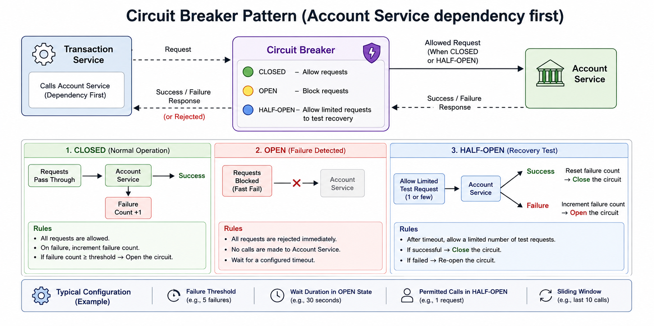
12
© 2026 by Innovation In Software Corporation
Notes:
KEY TALKING POINTS
------------------
- Top flow: Transaction Service, Circuit Breaker, Account Service
This matches the capstone precisely.
Transaction Service calls Account Service first, before saving or publishing anything, so this is the dependency to protect.
Requests reach Account Service only when the breaker is CLOSED, or as limited test calls when HALF-OPEN.
The return arrow reads success, failure, or rejected; rejected is what callers experience when the breaker is OPEN.
In Lab 3 that rejection surfaces as CallNotPermittedException inside Transaction Service and reaches the client as 503 ACCOUNT_SERVICE_UNAVAILABLE.
- 1. CLOSED (Normal Operation)
All requests pass through and the breaker records outcomes.
Correct one detail: the panel describes a failure count that opens the circuit when it reaches a threshold.
Resilience4j actually computes a failure rate over a sliding window and waits for a minimum number of calls before judging.
Lab 3 uses a sliding window of 6 calls, a minimum of 4 calls, and a 50 percent threshold.
A 409 for a FROZEN account is ignored, so business rejections never open the circuit.
- 2. OPEN (Failure Detected)
Every request is rejected immediately and no call reaches Account Service.
This is fail fast: the Transaction Service thread returns at once instead of waiting on connect and read timeouts.
The panel says wait for a configured timeout; in Resilience4j this is the wait duration in open state, 10 seconds in Lab 3, and the lab enables automatic transition to half-open when it expires.
During this window Account Service receives no traffic from this caller, which helps it recover.
- 3. HALF-OPEN (Recovery Test)
After the wait, a limited number of test calls are allowed through; Lab 3 permits 2.
If the test calls succeed, the circuit closes and the statistics reset.
If they fail, the circuit reopens for another wait.
In Resilience4j the decision again uses the failure rate across the permitted calls, so with 2 test calls and a 50 percent threshold, a single failure reopens the circuit.
Additional requests beyond the permitted test calls are rejected until the outcome is known.
- Typical Configuration strip
The strip's examples, 5 failures, 30 seconds, 1 half-open request, and a window of the last 10 calls, are generic illustrations.
Give participants the real Lab 3 values from the Transaction Service application.yml: slidingWindowSize 6, minimumNumberOfCalls 4, failureRateThreshold 50, waitDurationInOpenState 10s, and permittedNumberOfCallsInHalfOpenState 2.
They are deliberately small so the circuit opens after about four failed POSTs in class.
Production values should come from observed traffic volume and recovery times.
REAL-WORLD EXAMPLES
-------------------
- Resilience4j publishes circuit breaker state and call metrics through Spring Boot Actuator and Micrometer, so operations teams can alert when a breaker opens.
In a bank, an alert that the Account Service breaker opened inside Transaction Service can reach the on-call engineer before customers start calling the contact centre.
- A household circuit breaker trips when current exceeds a safe level, protecting the wiring rather than repairing the faulty appliance.
The software pattern borrows the name, adds automatic half-open testing so no one has to reset it by hand, and likewise protects the caller rather than fixing the dependency.
USE-CASE SCENARIO
-----------------
Rehearse the lab demo.
Start both services and post a transaction with the ops token: the breaker is CLOSED and the response is 201 RECEIVED.
Stop Account Service and post four more times: each returns 503 ACCOUNT_SERVICE_UNAVAILABLE after a connection failure, and the breaker records every one.
The circuit is now OPEN; the next POST returns 503 instantly, and Transaction Service makes no call to Account Service at all.
Restart Account Service and wait about 10 seconds.
The breaker moves to HALF-OPEN, lets test calls through, sees them succeed, and closes.
A POST returns 201 again, and no fake ACTIVE account was ever used.

Slide 14
CIRCUIT BREAKER STATES AND TRANSITIONS · BULKHEAD PATTERN
📌
THE THREE STATES
✅
RESILIENCE4J CONFIGURATION CONCEPT
📌
WHY BULKHEADS MATTER
• Closed: all calls allowed, success/failure rates monitored
• Open: calls blocked immediately, fail fast or use a fallback
• Half-open: a small number of test calls allowed after a wait duration
• Without isolation, one slow dependency can consume all available threads
• The term comes from ship compartments; in software it means separate thread pools, connection pools, or concurrency limits
• failure-rate-threshold: 50, sliding-window-size: 20, wait-duration-in-open-state: 30s
KEY TAKEAWAY Half-open allows a small number of test calls through -- success closes the circuit, failure reopens it immediately. • If reporting export hangs, Account Service should still serve balance lookups -- bulkheads are what make that guarantee possible.
13
© 2026 by Innovation In Software Corporation
Notes:
TOPIC 1 OF 2: Circuit Breaker States and Transitions
------------------------------------------
KEY TALKING POINTS
------------------
- THE THREE STATES
Closed is normal operation: every call goes through and the breaker keeps rolling statistics.
Open is protective: calls are refused immediately, and the code either fails fast or runs a fallback.
Half-open is the probe: after the wait, a small number of calls test whether the dependency has recovered, and success closes the circuit while failure reopens it.
Emphasise that the cycle is automatic.
Resilience4j can also open on slow calls, using a slow-call-rate threshold, even when those calls technically succeed.
- RESILIENCE4J CONFIGURATION CONCEPT
failure-rate-threshold 50 means the circuit opens when half or more of the recorded calls fail.
sliding-window-size 20 means that rate is computed over the last 20 calls.
wait-duration-in-open-state 30s is how long the circuit stays open before half-open testing.
These are concept values.
Lab 3's Transaction Service uses a window of 6, a minimum of 4 calls, the same 50 percent threshold, a 10 second wait, and 2 half-open calls, small enough to trip during a classroom demo.
REAL-WORLD EXAMPLES
-------------------
- A bank calling an external credit bureau during loan applications may need different breaker settings from an internal account lookup.
A busy internal service produces enough calls to judge failure quickly, while a low-volume external dependency needs a window sized so that two unlucky calls do not open the circuit.
Named Resilience4j instances, such as accountService in Lab 3, make that per-dependency tuning possible.
- Payment operations teams commonly place circuit breaker state beside error rate and latency on their dashboards.
A breaker flipping between open and half-open every few seconds is a recognisable signal that a dependency is only partly recovered, something a simple up or down health check would miss.
USE-CASE SCENARIO
-----------------
Use the lab's numbers to reason through a scenario.
Account Service starts failing every call.
Transaction Service's breaker needs a minimum of 4 calls, so the first three failures do not open it yet; each still returns 503 through the fallback.
On the fourth failure the failure rate is 100 percent, above the 50 percent threshold, and the circuit opens.
For 10 seconds every POST fails instantly.
Then the breaker goes half-open and allows 2 test calls.
If Account Service is back, both succeed and the circuit closes; if one fails, the rate is 50 percent and the circuit reopens.
TOPIC 2 OF 2: Bulkhead Pattern
------------------------------
KEY TALKING POINTS
------------------
- WHY BULKHEADS MATTER
A ship's hull is divided into watertight compartments so one breach floods one section, not the vessel.
In a service, the shared resources are the request thread pool, database connections, and outbound HTTP connections.
If a slow reporting export can take all of them, balance lookups starve even though nothing is wrong with balances.
Bulkheads cap each workload with a separate thread pool, a semaphore limiting concurrent calls, or a dedicated connection pool.
Rejections from a full bulkhead are fast and visible instead of silent queuing.
REAL-WORLD EXAMPLES
-------------------
- Netflix's Hystrix isolated each dependency in its own small thread pool by default, so a slow dependency could exhaust only its own pool while other calls continued.
Resilience4j offers the same idea as a thread pool bulkhead, plus a lighter semaphore bulkhead that limits concurrent calls without separate threads.
- Card authorisation is real-time and customer-facing, while the SMS alert about a purchase can lag by seconds without harm.
A card platform that isolates alert sending from authorisation processing ensures that a backlog at the SMS provider cannot slow authorisations at the checkout.
USE-CASE SCENARIO
-----------------
Extend the capstone hypothetically.
The reporting team asks for a CSV export of all accounts, served by the same Account Service instance that answers account lookups for Transaction Service.
One day the export query slows badly and holds most of the database connections.
Without a bulkhead, account lookups wait for connections, Transaction Service's 3 second read timeout starts firing, and its circuit breaker opens: a reporting problem has blocked transactions.
With the export limited to a few concurrent calls and its own pool, lookups continue normally.
Keep this a design discussion; Lab 3 adds no bulkhead code.

Slide 15
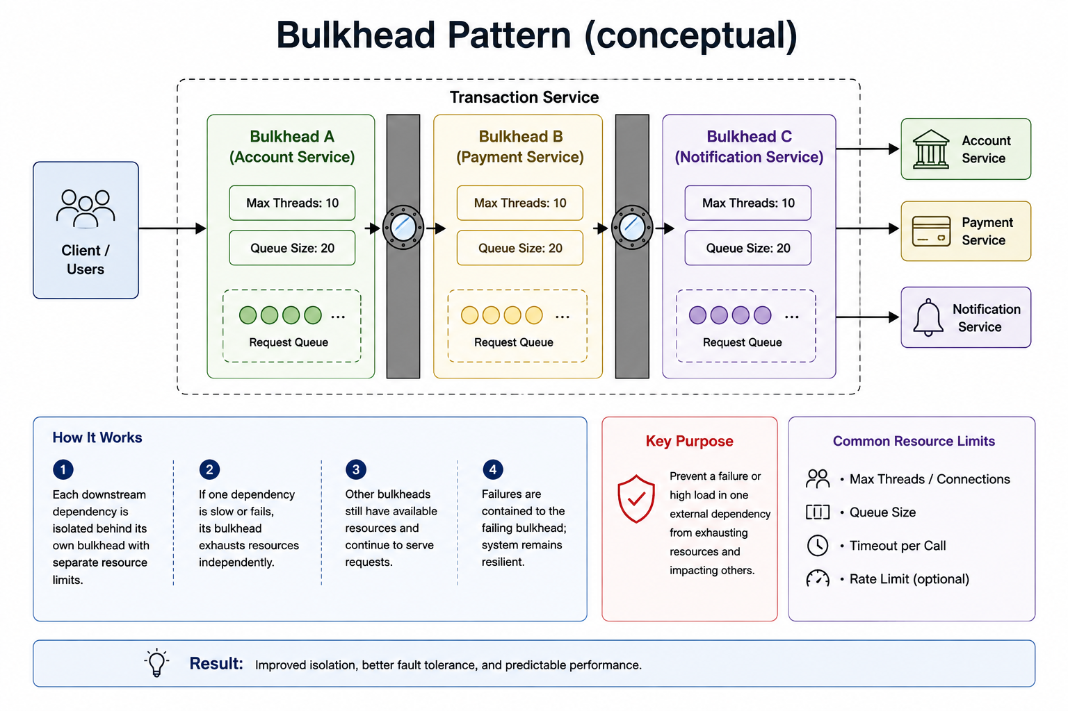
14
© 2026 by Innovation In Software Corporation
Notes:
KEY TALKING POINTS
------------------
- Client / Users and the Transaction Service boundary
Everything inside the dashed box is one deployable service.
Its incoming request threads are a finite resource; in a Spring MVC service on embedded Tomcat that pool is capped by server.tomcat.threads.max.
The point of the diagram is that this single service talks to several dependencies, and without internal partitions every one of those calls competes for the same threads.
Say clearly that bulkheads live inside the caller, not in the downstream service.
- Bulkheads A, B and C
Each compartment is a separate, bounded resource pool for one dependency: at most 10 threads working and 20 requests waiting.
Max threads plus a queue is the thread-pool style of bulkhead; in Resilience4j those map to max-thread-pool-size and queue-capacity under resilience4j.thread-pool-bulkhead.
Correct one visual impression: the arrows pass through A, then B, then C, which looks like a pipeline.
Real compartments sit side by side, and a request only enters the compartment for the dependency it is calling.
- Downstream services
The right column shows Account Service, Payment Service and Notification Service.
Treat Payment and Notification as illustrations.
In our capstone, Transaction Service has exactly one synchronous dependency, Account Service on port 8081, and it reaches Risk Assessment Service asynchronously through the Kafka topic transactions.submitted.
The broker already decouples that second path, so only the Account call would ever need a bulkhead.
The lesson transfers to any service with several synchronous dependencies.
- How It Works
Four numbered steps tell the story.
First, every downstream dependency is isolated behind its own limits.
Second, if one dependency becomes slow or fails, only its bulkhead fills up and exhausts its own threads and queue.
Third, the other bulkheads still have free capacity and keep serving requests.
Fourth, the failure is contained to one compartment, so the service as a whole stays responsive.
Emphasise that calls rejected by a full bulkhead must fail quickly with a clear error.
- Key Purpose
The red panel states the goal: stop a failure or traffic spike in one external dependency from exhausting resources and dragging down unrelated work.
The underlying failure mode is thread starvation.
A dependency that hangs does not return errors, it holds threads, and held threads are invisible until the whole service stops answering.
A bulkhead turns that silent starvation into a bounded, measurable rejection count for just one dependency.
- Common Resource Limits
The right panel lists the knobs: max threads or connections, queue size, a timeout per call, and an optional rate limit.
Stress that these work together.
A bulkhead without a timeout still fills with stuck calls; a timeout frees the slot.
Queue size deserves caution because a very large queue hides trouble and adds latency.
Resilience4j's semaphore bulkhead uses max-concurrent-calls and max-wait-duration instead of threads and queues.
- Result
The banner summarises the payoff as improved isolation, better fault tolerance and predictable performance.
Predictable is the key word for banking: customers and operations teams can tolerate a feature being briefly unavailable far better than a whole channel freezing without explanation.
Connect it back to the building blocks already covered: timeouts bound how long, circuit breakers decide whether to call at all, and bulkheads bound how many calls run at once.
REAL-WORLD EXAMPLES
-------------------
- Debit card authorisation and SMS alert delivery often run in the same platform.
If the SMS gateway slows down, alert calls should queue in their own small pool while authorisation traffic keeps its dedicated capacity, because a delayed text is an annoyance and a declined purchase at a till is a customer incident.
- Netflix built Hystrix to wrap each remote dependency in its own thread pool so that one failing service could not consume every request thread.
Hystrix is now in maintenance mode, and its project page points teams to Resilience4j, the library this course uses.
- A bank's internal reporting export and its customer balance lookup may share one database.
Giving the export its own smaller connection pool keeps a long-running report from taking every connection that balance lookups need during business hours.
USE-CASE SCENARIO
-----------------
Picture Transaction Service later growing a second synchronous dependency, say a slow statement archive used for a transaction-history enrichment feature.
On a busy morning the archive starts answering in tens of seconds.
Every enrichment call holds a Tomcat request thread, and within minutes new POST /api/v1/transactions requests cannot get a thread at all, even though Account Service is perfectly healthy.
With a bulkhead around the archive client, at most a small number of archive calls run at once; extra calls are rejected immediately and the history screen shows enrichment as unavailable.
Transaction submission keeps flowing to Account Service validation and the transactions.submitted topic, so Risk Assessment Service keeps receiving work.

Slide 16
SEMAPHORE VS. THREAD-POOL BULKHEADS · RATE LIMITING AND THROTTLING · FALLBACK STRATEGIES
📌
TWO BULKHEAD IMPLEMENTATIONS
✅
WHEN TO USE EACH
📌
COMMON ALGORITHMS
• Semaphore bulkhead: limits concurrent access without a separate thread pool, lightweight
• Thread pool bulkhead: uses a separate thread pool, can queue calls before rejection
• Semaphore: reactive or non-blocking applications
• Thread pool: blocking operations that need full isolation of thread resources
• Fixed window, sliding window, token bucket, leaky bucket
• Token bucket: tokens refill over time; each request consumes one, allowing controlled bursts
✅
WHERE IT'S APPLIED
📌
FALLBACK OPTIONS
⚠️
THE GOLDEN RULE
• API gateway, load balancer, service mesh, application code, or the external API client
• Exceeding the limit returns 429 Too Many Requests
• Return cached reference data, mark a transaction as pending, return a controlled error
• Queue work for later processing, or disable a non-critical feature
• Fallbacks must be business-approved and must never invent or fabricate critical data
KEY TAKEAWAY A semaphore is lightweight and non-blocking by default; a thread pool bulkhead adds true isolation at the cost of managing its own threads. • Fixed window, sliding window, token bucket, and leaky bucket algorithms each shape traffic differently, but all exist to protect capacity. • Returning a fabricated account balance is never acceptable; hiding a marketing offer when the recommendation service is down usually is.
15
© 2026 by Innovation In Software Corporation
Notes:
TOPIC 1 OF 3: Semaphore vs. Thread-Pool Bulkheads
------------------------------------------
KEY TALKING POINTS
------------------
- TWO BULKHEAD IMPLEMENTATIONS
A semaphore bulkhead is a counter of permits.
The call still runs on the caller's own thread; if no permit is free, the call waits up to max-wait-duration, which defaults to zero, and then fails with BulkheadFullException.
It costs almost nothing.
A thread-pool bulkhead hands the call to a dedicated bounded pool with its own queue, so the caller's thread is never blocked by the slow dependency.
In Resilience4j that style needs an asynchronous return type such as CompletableFuture.
- WHEN TO USE EACH
The slide's guidance is a sensible starting point, with one addition.
Semaphore bulkheads suit reactive and non-blocking code, and they are also Resilience4j's default choice for ordinary synchronous Spring MVC code when you simply want to cap how many calls hit one dependency.
Choose a thread-pool bulkhead for blocking calls where you must guarantee the caller's request threads are never tied up, and accept the cost of managing another pool, context switching and an asynchronous method signature.
REAL-WORLD EXAMPLES
-------------------
- A card authorisation service calling a third-party tokenisation API might use a semaphore bulkhead of a few dozen permits.
Calls run on the existing request threads, and the permit count simply prevents a slow provider from occupying all of them at once.
- A loan origination service that calls a slow, blocking credit bureau connector is a classic thread-pool bulkhead case: the bureau calls run on their own small pool and queue, so the web threads serving application status pages stay free.
USE-CASE SCENARIO
-----------------
In the capstone, Transaction Service calls Account Service through a synchronous RestClient in AccountClient.requireActiveAccount.
If the team ever wanted to cap concurrency there, a semaphore bulkhead would be the natural fit: no change to the method signature, tiny overhead, and a clear BulkheadFullException when too many validations are already in flight.
A thread-pool bulkhead would force the method to return a CompletableFuture and ripple through the controller.
Lab 3 does not add either; it relies on the 2 second connect and 3 second read timeouts plus a circuit breaker, which is the right first step.
TOPIC 2 OF 3: Rate Limiting and Throttling
------------------------------------------
KEY TALKING POINTS
------------------
- COMMON ALGORITHMS
Fixed window counts requests per clock interval; it is simple but allows a double burst at the boundary.
Sliding window smooths that by looking at the most recent interval.
Token bucket adds tokens at a steady rate up to a maximum; each request spends one, so short bursts are allowed while the average rate is enforced.
Leaky bucket processes requests at a constant outflow rate, smoothing bursts into an even stream.
All four answer the same question: how much work may enter per unit of time.
- WHERE IT'S APPLIED
Limits can be enforced at the API gateway, load balancer, service mesh, inside application code, or in the client calling an external API.
For public and partner-facing banking APIs, the gateway is usually the preferred place because it stops excess traffic before it reaches any service.
In-code limiters protect a specific expensive dependency.
The standard response is 429 Too Many Requests, ideally with a Retry-After header, never a generic 500 that makes clients think the service is broken.
REAL-WORLD EXAMPLES
-------------------
- Online banking login endpoints throttle attempts per user and per source to slow credential-stuffing attacks.
The limit is a security control as much as a capacity control, so security teams usually help set it.
- Banks exposing partner APIs to aggregators and fintechs commonly apply per-client quotas at an API management layer, such as Red Hat 3scale on OpenShift, so one partner's batch job cannot crowd out others.
USE-CASE SCENARIO
-----------------
Suppose a partner integration starts replaying a backlog and floods POST /api/v1/transactions on Transaction Service.
Without limits, each request triggers an Account Service lookup and a Kafka publish, so the spike propagates to Account Service and to Risk Assessment Service's consumer lag.
A per-client limit at the gateway returns 429 with Retry-After to that partner while other callers continue normally.
Account Service sees steady load, and the risk pipeline keeps up.
The partner's retries back off instead of hammering the platform.
TOPIC 3 OF 3: Fallback Strategies
---------------------------------
KEY TALKING POINTS
------------------
- FALLBACK OPTIONS
Each option fits a different kind of data.
Cached reference data, like branch lists or currency codes, changes slowly, so a clearly marked cached copy is acceptable.
Marking a transaction pending moves it to review instead of approving blindly.
A controlled error, such as 503 with a clear code, is often the most honest choice.
Queuing defers work that does not need an immediate answer, like notifications.
Disabling a non-critical feature hides offers or recommendations while core banking keeps working.
- THE GOLDEN RULE
A fallback is a business decision written in code, so product, risk and compliance owners must agree to it.
The dangerous fallback is one that looks like success: a default balance, an assumed ACTIVE account, an automatic fraud approval.
Those hide the outage from monitoring and can move money incorrectly.
In Lab 3 this rule is concrete: when Account Service is down or the circuit is open, the fallback throws and the API returns 503 ACCOUNT_SERVICE_UNAVAILABLE.
It must never return a synthetic ACTIVE account.
REAL-WORLD EXAMPLES
-------------------
- When a fraud scoring provider is unavailable during a wire transfer, banks typically place the transfer into a pending review state rather than approving it, because the cost of an unscreened fraudulent wire far exceeds a short delay for a legitimate customer.
- A mobile banking dashboard whose personalised offers service is down can simply omit the offers carousel.
Nobody is harmed by missing a credit card promotion, so this fallback needs little approval.
USE-CASE SCENARIO
-----------------
During Lab 3, a learner asks Copilot to make the circuit breaker fallback friendlier, and it suggests returning new AccountView(accountId, ACTIVE, USD) so transactions keep flowing.
That single line would let Transaction Service accept money movement against an account that might be frozen, closed or nonexistent, and it would publish TransactionSubmitted to Kafka so Risk Assessment Service scores a transaction that should never exist.
The correct fallback in the lab throws AccountServiceUnavailableException, returns 503, writes no row and publishes nothing.
The client can retry later, and operations can see the outage in the logs.

Slide 17
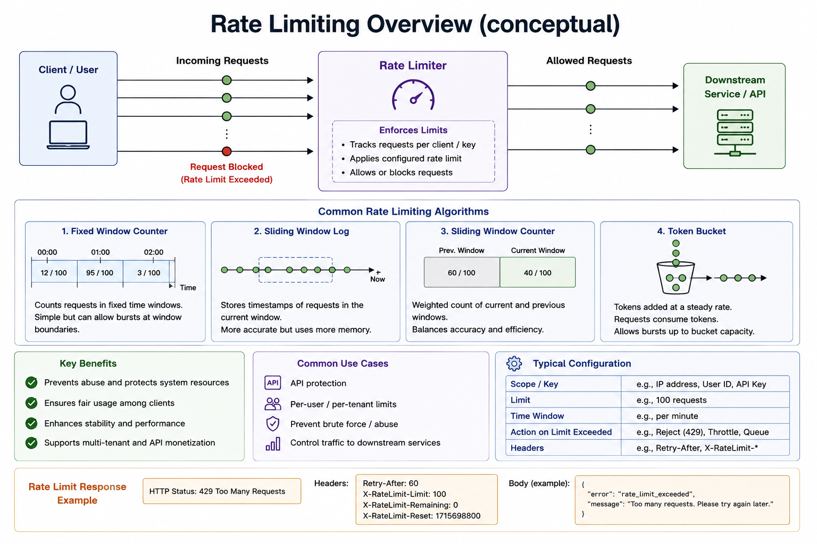
16
© 2026 by Innovation In Software Corporation
Notes:
KEY TALKING POINTS
------------------
- Request flow: Client, Rate Limiter, Downstream Service
Read the top row left to right.
Every request from a client is counted against a key, usually a user ID, API key, or IP address.
While the caller is under its limit, the request passes through unchanged to the downstream API.
The red dot is the request that pushed the caller over the limit; it is rejected before it ever reaches the service, so the service spends no threads or database connections on it.
The limiter protects capacity, not correctness.
- Common Rate Limiting Algorithms
Fixed window counts requests per clock minute; it is cheap but a caller can send a full quota at 00:59 and another at 01:00, doubling the burst at the boundary.
Sliding window log stores every timestamp, so it is exact but memory-hungry.
Sliding window counter blends the previous and current window counts, a good balance of accuracy and cost.
Token bucket refills tokens at a steady rate and lets bursts up to the bucket size, which suits real client traffic well.
- Key Benefits and Common Use Cases
The benefits are protecting shared resources, fairness so one noisy client cannot starve others, stability under spikes, and support for tiered partner plans.
The use cases map directly to banking: protecting public APIs, per-customer or per-partner quotas, slowing brute-force attempts on login or one-time passcode endpoints, and shielding a fragile downstream system such as a core banking host that can only handle a fixed request rate.
- Typical Configuration
Every limit is defined by five choices: the key you count against, the limit, the time window, what happens when the limit is exceeded, and which headers you return.
Rejecting with 429 is most common, but throttling or queueing are alternatives for internal batch traffic.
The key matters most: limiting by IP address alone punishes many customers behind one corporate proxy, while limiting by authenticated user or client ID is fairer and harder to evade.
- Rate Limit Response Example
The bottom strip shows a well-behaved rejection: HTTP 429 Too Many Requests, a Retry-After header telling the client how many seconds to wait, and informational headers showing the limit, remaining quota, and reset time.
Retry-After is a standard HTTP header; the X-RateLimit headers are a widely used convention rather than a formal standard.
The JSON body gives a stable error code the client can act on, never a stack trace.
REAL-WORLD EXAMPLES
-------------------
- Online banking login and one-time passcode verification endpoints are commonly limited per username and per device, so an attacker cannot try thousands of passwords or codes; the limit is deliberately much stricter than for balance lookups.
- Open banking and partner APIs usually publish per-client quotas enforced at the API gateway, so an aggregator polling balances too aggressively receives 429 responses instead of slowing down the service for the bank's own mobile customers.
USE-CASE SCENARIO
-----------------
A fintech partner integrates with the capstone platform and, because of a bug in its scheduler, starts calling GET /api/v1/transactions in a tight loop.
Without a limit, Transaction Service threads and database connections fill up and the bank's own tellers see slow responses.
With a gateway rate limit keyed on the partner's client ID, say a token bucket allowing short bursts, the partner starts receiving 429 with Retry-After while every other caller is unaffected.
Operations sees the rejection metric rise, contacts the partner, and nothing in Transaction Service had to change.
In Lab 3 this stays a design discussion; the hands-on work is the timeout and circuit breaker.

Slide 18
GRACEFUL DEGRADATION · LOAD SHEDDING · RESILIENCE4J OVERVIEW
📌
WHAT GRACEFUL DEGRADATION MEANS
📌
HOW LOAD SHEDDING WORKS
📌
WHY RESILIENCE4J
• The system provides reduced functionality instead of failing completely
• For critical banking operations, degradation must still follow business and compliance rules
• The service monitors its own saturation (CPU, threads, queue depth)
• When capacity is exceeded, lower-priority requests are rejected early, before they consume resources
• Protects the service's ability to serve its most important traffic
• Lightweight and fast, fault tolerant by design
• Rich metrics and events, production ready
• Modules for Retry, CircuitBreaker, Bulkhead, RateLimiter, and TimeLimiter
KEY TAKEAWAY If Recommendation Service is unavailable, the dashboard still shows balances and transactions -- it simply hides personalized offers. • When demand exceeds capacity, shedding low-priority traffic protects the requests that matter most from a total system collapse. • Timeout, retry, circuit breaker, bulkhead, and rate limiter modules share one consistent configuration style across a Spring Boot service.
17
© 2026 by Innovation In Software Corporation
Notes:
TOPIC 1 OF 3: Graceful Degradation
----------------------------------
KEY TALKING POINTS
------------------
- WHAT GRACEFUL DEGRADATION MEANS
Graceful degradation is designing a feature so that losing one dependency removes one piece of the experience rather than the whole page or workflow.
It requires knowing in advance which parts are core and which are optional.
The second bullet is the banking twist: degradation must never quietly weaken controls.
Hiding offers is fine; skipping a sanctions check, approving without a fraud score or showing an invented balance is not.
Sometimes the correct degraded behaviour for a critical operation is to stop safely.
REAL-WORLD EXAMPLES
-------------------
- A retail banking app can keep showing balances and recent card transactions when its rewards points service is down, displaying a small rewards temporarily unavailable message instead of an error screen.
- Online bill pay may keep accepting scheduled payments for later processing when the real-time payment rail is unavailable, while clearly telling the customer the payment will be sent when the service recovers rather than pretending it has already gone.
USE-CASE SCENARIO
-----------------
In the capstone, Risk Assessment Service consumes transactions.submitted from Kafka and adds a risk score.
If it is slow or down, Transaction Service can still accept valid transactions and publish them; they simply wait in the topic, and their risk results arrive later.
That is graceful degradation built into the architecture.
The opposite dependency is not optional: if Account Service is down, Transaction Service cannot confirm the account is ACTIVE, so it must return 503 rather than degrade into accepting unchecked transactions.
TOPIC 2 OF 3: Load Shedding
---------------------------
KEY TALKING POINTS
------------------
- HOW LOAD SHEDDING WORKS
Load shedding is a service protecting itself based on its own health, unlike rate limiting, which enforces a fixed quota per client.
The service measures saturation, for example busy request threads, connection pool usage or queue depth.
When those cross a threshold it rejects the cheapest-to-refuse, lowest-priority requests at the front door, often with 503 or 429, before any database or downstream work starts.
Rejecting early is the whole point: a request that is dropped after half its work has already burned the capacity you were trying to save.
REAL-WORLD EXAMPLES
-------------------
- On salary day, a bank's mobile platform may keep serving logins, balances and transfers while temporarily refusing heavy, lower-priority requests such as full-year statement PDF generation, asking customers to try again later.
- Amazon's Builders' Library publishes an article on using load shedding to avoid overload, describing how services reject excess requests cheaply so that the requests they do accept still complete within their latency targets.
USE-CASE SCENARIO
-----------------
Imagine a marketing campaign sends a surge of transaction-history reads to Transaction Service at the same moment ops staff are posting urgent transactions.
If the service treats all requests equally, both kinds slow down and time out together.
With load shedding keyed to saturation, the service notices its request threads and database connections are nearly exhausted and starts rejecting low-priority history reads immediately with a retry-later response.
POST /api/v1/transactions keeps getting threads, Account Service validation still completes inside its timeout, and events keep reaching Risk Assessment Service.
TOPIC 3 OF 3: Resilience4j Overview
-----------------------------------
KEY TALKING POINTS
------------------
- WHY RESILIENCE4J
Resilience4j is a modular library: you add only the pieces you need, and each decorates a function or method.
Version 2 targets Java 17 and later, which fits our Java 21 labs, and the resilience4j-spring-boot3 starter binds everything from application.yml under resilience4j.<module>.instances.<name>.
Annotations such as @CircuitBreaker also need Spring AOP on the classpath.
Each module publishes events and, with Micrometer and Actuator present, metrics.
TimeLimiter is the timeout module.
It is the maintained successor that the Netflix Hystrix project now recommends.
REAL-WORLD EXAMPLES
-------------------
- Teams migrating older Spring Cloud Netflix applications off Hystrix commonly move to Resilience4j, often through the Spring Cloud CircuitBreaker abstraction, keeping the same circuit breaker and fallback concepts with a lighter library.
- A payments platform team can standardise one application.yml convention across dozens of services, naming instances after the dependency they protect, so operations dashboards show consistent circuit breaker metrics for every downstream call.
USE-CASE SCENARIO
-----------------
In Lab 3, the Transaction Service starter already includes Resilience4j and an application.yml block for an instance called accountService: sliding window of 6 calls, a minimum of 4 calls before evaluating, 50 percent failure-rate threshold, 10 seconds in the open state, and 2 trial calls when half-open.
AccountNotEligibleException is listed under ignoreExceptions so a legitimate 409 for a FROZEN account does not trip the breaker.
Learners add one annotation on AccountClient.requireActiveAccount and write fallbacks.
The next slides show the other modules they will not install in the lab but should understand.

Slide 19
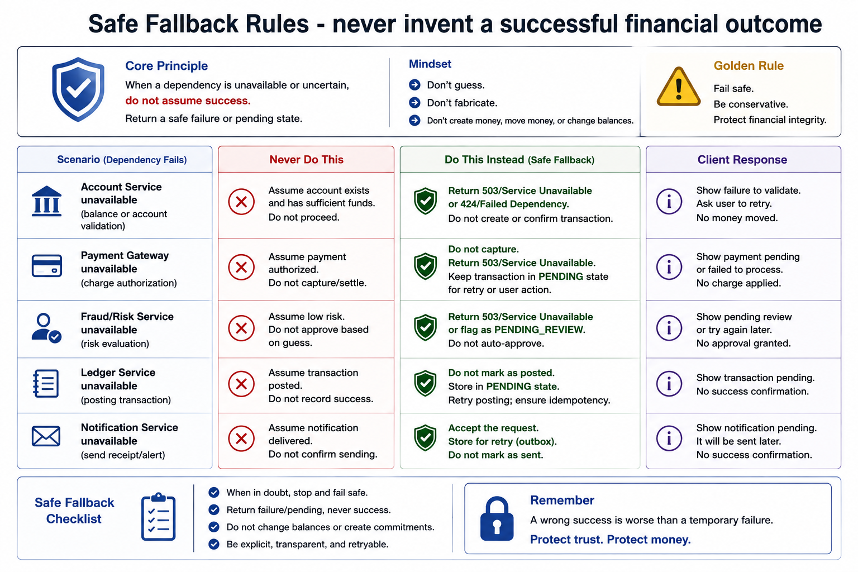
18
© 2026 by Innovation In Software Corporation
Notes:
KEY TALKING POINTS
------------------
- Core principle and golden rule
When a dependency is down or the answer is uncertain, the service must not pretend the happy path happened.
Return a clear failure or a pending state.
The mindset is simple: do not guess, do not fabricate, and do not create money, move money, or change balances from a missing response.
Fail safe, stay conservative, and protect financial integrity.
A temporary 503 is recoverable.
A invented success becomes a ledger problem, a customer dispute, and an audit finding.
- Account Service unavailable
This row is the Lab 3 rule in one line.
If Account Service on port 8081 cannot confirm the account, Transaction Service on port 8082 must not assume the account exists, is ACTIVE, or has funds.
It returns 503 ACCOUNT_SERVICE_UNAVAILABLE, or in some enterprises a failed-dependency code, and it does not create or confirm the transaction.
No Kafka event is published.
The client is told to retry later.
That is exactly what the Resilience4j fallback around AccountClient.requireActiveAccount must do, and it must never invent ACTIVE.
- Other money-moving dependencies
The same rule applies when a payment gateway, fraud or risk service, or ledger is unavailable.
Do not capture or settle a charge you could not authorise.
Do not auto-approve because a risk engine timed out.
Do not mark a posting as complete because the ledger did not answer.
Notifications are the exception that proves the rule: you may accept the original request and retry the email later, but you still must not tell the customer the alert was sent.
Pending and retryable beats a false confirmation.
- A wrong success is worse than a temporary failure
The checklist at the bottom is the classroom test.
When in doubt, stop and fail safe.
Return failure or pending, never success.
Do not change balances or create commitments.
Be explicit so the client can retry.
Customers dislike a 503.
They dislike a posted transfer that should never have been accepted even more.
Lab 3 encodes that judgement: the circuit breaker fails fast, the fallback throws 503, and the transaction row and the transactions.submitted event do not exist.
REAL-WORLD EXAMPLES
-------------------
- Card authorisation systems decline or return a try-again code when the issuer cannot be reached.
They do not approve a purchase because the timeout felt like a probably-good customer.
A false approve is a chargeback; a decline is a retry.
- Wire-transfer desks park a payment in a pending-repair queue when the sanctions-screening service is down.
They do not release the wire on a guessed low-risk score and then hope screening catches up.
USE-CASE SCENARIO
-----------------
A teller posts a transfer on the AI-Assisted Banking Transaction Risk Platform while Account Service on port 8081 is restarting.
Transaction Service on port 8082 hits the RestClient timeout, the Resilience4j circuit breaker opens after repeated failures, and the fallback returns 503 ACCOUNT_SERVICE_UNAVAILABLE.
No RECEIVED row is saved and no TransactionSubmitted event reaches Kafka, so Day 5 Risk Assessment never scores a transaction that was never validated.
The teller retries after the account pod is up.
That is the whole diagram: fail safe, tell the truth, and never invent ACTIVE.

Slide 20
IMPLEMENTING TIMEOUTS WITH RESILIENCE4J · IMPLEMENTING RETRIES WITH RESILIENCE4J · IMPLEMENTING CIRCUIT BREAKERS
📌
CONFIGURATION CONCEPT
📌
CONFIGURATION CONCEPT
• resilience4j.timelimiter.instances.accountService.timeout-duration: 2s
• @TimeLimiter(name = "accountService") on the client method
• Pairs naturally with a fallback method for the timeout case
• resilience4j.retry.instances.accountService.max-attempts: 3
• resilience4j.retry.instances.accountService.wait-duration: 500ms
• Combine with exponential backoff and jitter, and target only transient failures
📌
SPRING BOOT EXAMPLE
✅
METRICS AND EVENTS
• @CircuitBreaker(name = "externalService", fallbackMethod = "fallback")
• sliding-window-size, minimum-number-of-calls, failure-rate-threshold, wait-duration-in-open-state
• Micrometer auto-registers resilience4j.circuitbreaker.calls, .state, .successful.calls, and more
• Key events: OnSuccess, OnError, OnSlowCall, OnCallNotPermitted, OnStateTransition
KEY TAKEAWAY @TimeLimiter combined with a fallback method turns a hung downstream call into a controlled, predictable failure instead of an indefinite wait. • max-attempts and wait-duration in application.yml are all it takes to add safe, bounded retry behavior to a Spring Boot client call. • A sliding window of recent calls, a failure-rate threshold, and a wait-duration-in-open-state fully define a Resilience4j circuit breaker.
19
© 2026 by Innovation In Software Corporation
Notes:
TOPIC 1 OF 3: Implementing Timeouts with Resilience4j
------------------------------------------
KEY TALKING POINTS
------------------
- CONFIGURATION CONCEPT
The property resilience4j.timelimiter.instances.accountService.timeout-duration is real, and its default is 1 second.
One important correction: in Resilience4j, @TimeLimiter only works on methods returning an asynchronous type such as CompletableFuture or a reactive Mono or Flux.
It cannot interrupt an ordinary blocking RestClient call.
For synchronous clients, set connect and read timeouts on the HTTP client itself.
That is exactly what Lab 3 does: RestClient uses a 2 second connect and 3 second read timeout, and no TimeLimiter is added.
REAL-WORLD EXAMPLES
-------------------
- A card authorisation gateway usually allows a fraud scoring call only a fraction of the overall authorisation window, because the card network expects an answer quickly; if scoring does not answer in time, the gateway applies its agreed fallback instead of waiting.
- A reactive mobile banking back end built on WebClient can use a TimeLimiter or the Mono timeout operator around a call to a slow exchange-rate provider, returning a clearly marked last-known rate if policy allows.
USE-CASE SCENARIO
-----------------
Early in Lab 3, a learner stops Account Service and posts a transaction.
Because the RestClient has a 2 second connect timeout, the call fails quickly and AccountClient converts the error into AccountServiceUnavailableException, which surfaces as 503.
Now imagine the same code with no timeouts and Account Service accepting connections but never replying: each POST /api/v1/transactions would hold a request thread indefinitely, and after enough of them Transaction Service would stop answering entirely, including requests that have nothing to do with Account Service.
TOPIC 2 OF 3: Implementing Retries with Resilience4j
------------------------------------------
KEY TALKING POINTS
------------------
- CONFIGURATION CONCEPT
max-attempts counts the original call, so 3 means one call plus two retries.
wait-duration is the pause between attempts.
Backoff and jitter are enabled with enable-exponential-backoff, exponential-backoff-multiplier and enable-randomized-wait.
retry-exceptions and ignore-exceptions decide what is transient: timeouts and 503s may be retried; validation errors, 401, 403 and business rejections such as a frozen account must not be.
Always do the latency arithmetic: with a 3 second read timeout, three attempts plus two 500 ms waits can take about 10 seconds.
REAL-WORLD EXAMPLES
-------------------
- A notification service sending payment confirmation emails can safely retry a provider's temporary 503 a few times with backoff, because resending an email request is low risk and the provider often recovers within seconds.
- AWS's architecture guidance on exponential backoff and jitter explains why many clients retrying on the same schedule create synchronised waves that re-overload a recovering service, and why randomising the delay spreads that load out.
USE-CASE SCENARIO
-----------------
A team proposes adding @Retry around the whole POST /api/v1/transactions handler in Transaction Service so that brief Account Service blips are hidden.
Walk through what happens: the handler persists a RECEIVED transaction and publishes to Kafka, so a retry after a partial failure could create a duplicate transaction and a duplicate risk assessment.
The safer design retries only the idempotent GET to Account Service, with a small attempt count that fits the latency budget, or uses an idempotency key on the POST.
Lab 3 adds no retry at all and relies on timeouts plus a circuit breaker.
TOPIC 3 OF 3: Implementing Circuit Breakers
------------------------------------------
KEY TALKING POINTS
------------------
- SPRING BOOT EXAMPLE
The annotation names an instance and a fallback method in the same class with a compatible signature plus an exception parameter.
The breaker counts outcomes in a sliding window; once minimum-number-of-calls is reached, if the failure rate exceeds failure-rate-threshold it opens and rejects calls with CallNotPermittedException.
After wait-duration-in-open-state it goes half-open and allows a few trial calls.
Lab 3 uses name accountService: window 6, minimum 4 calls, 50 percent threshold, 10 seconds open, 2 half-open calls, which is why four failed POSTs open it.
- METRICS AND EVENTS
With Actuator and Micrometer present, Resilience4j registers meters such as resilience4j.circuitbreaker.state, resilience4j.circuitbreaker.failure.rate and resilience4j.circuitbreaker.calls.
Successful, failed, ignored and not-permitted calls are distinguished by a kind tag on the calls meter rather than separate meter names.
The event publisher offers onSuccess, onError, onIgnoredError, onCallNotPermitted, onStateTransition, and rate-exceeded events including onSlowCallRateExceeded; there is no plain OnSlowCall hook.
Note that Lab 3 exposes only health and info, so metrics must be added to the exposure list to view them.
REAL-WORLD EXAMPLES
-------------------
- A loan origination service calling a credit bureau opens its breaker when the bureau starts failing, so new applications move straight to pending manual review instead of each one waiting for a timeout and tying up threads.
- Operations teams at banks commonly alert on a circuit breaker transitioning to OPEN for a payment or fraud dependency, because a state change is an early, unambiguous signal that a downstream system is in trouble.
USE-CASE SCENARIO
-----------------
In Lab 3 Step 5, learners stop Account Service and send POST /api/v1/transactions with the ops token four times.
Each call fails inside the RestClient timeout and returns 503 ACCOUNT_SERVICE_UNAVAILABLE.
After the fourth failure the accountService breaker opens, and further requests are rejected instantly with CallNotPermittedException, which the fallback turns into the same 503 without touching the network.
Learners then restart Account Service, wait about 10 seconds for the half-open state, and a later POST succeeds.
AccountCircuitBreakerTest proves the OPEN behaviour in mvn test.

Slide 21
IMPLEMENTING BULKHEADS · IMPLEMENTING RATE LIMITERS · COMBINING RESILIENCE PATTERNS SAFELY
📌
CONFIGURATION EXAMPLE
📌
CONFIGURATION EXAMPLE
• resilience4j.bulkhead.instances.externalService.max-concurrent-calls: 10
• type: SEMAPHORE or THREADPOOL, with queue-capacity for thread-pool bulkheads
• Use BulkheadFullException to provide a graceful fallback when capacity is exhausted
• resilience4j.ratelimiter.instances.externalService.limit-for-period: 10
• limit-refresh-period: 1s, timeout-duration: 500ms, timeout-behavior: WAIT or FAIL_FAST
📌
RECOMMENDED EXECUTION ORDER
❌
COMMON ANTI-PATTERNS
1. Timeout -- fail fast
2. Circuit Breaker -- stop failing fast
3. Retry -- recover from transient failures
4. Bulkhead -- isolate and contain
5. Rate Limiter -- control traffic
6. Fallback -- provide graceful behavior
• Retrying non-idempotent operations, retries without backoff or jitter
• Unlimited bulkhead thread pools, overusing too many patterns at once
KEY TAKEAWAY max-concurrent-calls and max-wait-duration cap how many requests can be in flight to one dependency at any moment. • limit-for-period and limit-refresh-period define a token bucket; excess calls wait, or fail fast with RequestNotPermittedException. • Applying patterns in this recommended sequence protects the provider first, protects your own threads second, and degrades gracefully last.
20
© 2026 by Innovation In Software Corporation
Notes:
TOPIC 1 OF 3: Implementing Bulkheads
------------------------------------
KEY TALKING POINTS
------------------
- CONFIGURATION EXAMPLE
For the default semaphore bulkhead, resilience4j.bulkhead.instances.<name> takes max-concurrent-calls and max-wait-duration, how long a caller waits for a permit before BulkheadFullException.
One correction to the slide: the type is not a yml property.
You choose it on the annotation, @Bulkhead(name, type = Bulkhead.Type.THREADPOOL), and thread-pool settings such as max-thread-pool-size, core-thread-pool-size and queue-capacity live under a separate resilience4j.thread-pool-bulkhead namespace.
A fallback that catches BulkheadFullException should return a fast, honest response, not fake data.
REAL-WORLD EXAMPLES
-------------------
- A customer service platform calling a slow document imaging system can cap those calls at a small number of concurrent requests, so agents opening scanned cheques do not starve agents looking up account details.
- A statement service might give PDF rendering its own thread-pool bulkhead with a short queue, so month-end rendering spikes reject quickly with a try-later message instead of slowing every other statement request.
USE-CASE SCENARIO
-----------------
Suppose Account Service gains a reporting export endpoint that calls a slow data warehouse.
Under month-end load the export calls pile up and begin to crowd out the GET /api/v1/accounts/{id} lookups that Transaction Service depends on.
Adding a semaphore bulkhead around the warehouse client with a modest max-concurrent-calls and a max-wait-duration of zero means excess exports fail immediately with BulkheadFullException, mapped to a clear retry-later error.
Account lookups keep their threads, Transaction Service keeps validating accounts inside its 3 second read timeout, and the circuit breaker in Lab 3 never needs to open.
TOPIC 2 OF 3: Implementing Rate Limiters
----------------------------------------
KEY TALKING POINTS
------------------
- CONFIGURATION EXAMPLE
limit-for-period is how many calls are permitted per cycle, limit-refresh-period is the cycle length, and timeout-duration is how long a caller waits for a permission before RequestNotPermittedException.
So 10 per 1 second, waiting up to 500 ms. Two corrections: Resilience4j has no timeout-behavior property.
To fail fast you set timeout-duration to 0; a positive value means wait.
And although the subtitle says token bucket, Resilience4j refreshes permissions at the start of each cycle without banking unused ones, which behaves more like a fixed window with permits.
REAL-WORLD EXAMPLES
-------------------
- A bank calling a paid external identity verification API with a contractual calls-per-second cap can use an in-code rate limiter so its own services never exceed the contract, rather than discovering the cap through rejected requests.
- An internal batch job that re-scores historical transactions can be throttled with a rate limiter so it does not overwhelm the scoring service that also handles real-time traffic.
USE-CASE SCENARIO
-----------------
Picture Risk Assessment Service in a later lab calling an external scoring model endpoint with a strict quota.
During a Kafka backlog replay, the consumer could fire far more scoring requests than the quota allows, earning 429s from the provider.
A Resilience4j rate limiter around the scoring client with a limit-for-period matching the quota and a short timeout-duration keeps outbound calls inside the contract.
Excess messages simply wait, and because Kafka consumers pull work, the backlog drains at a controlled pace without losing transactions.
TOPIC 3 OF 3: Combining Resilience Patterns Safely
------------------------------------------
KEY TALKING POINTS
------------------
- RECOMMENDED EXECUTION ORDER
Read this list as a design checklist: first bound time, then decide whether to call at all, then decide what to retry, then cap concurrency and rate, and finally define fallback.
The runtime wrapping is different.
Resilience4j's default annotation order is Retry outermost, then CircuitBreaker, RateLimiter, TimeLimiter and Bulkhead around the call, adjustable with aspect-order properties.
So each retry attempt passes through the breaker; configure retry to ignore CallNotPermittedException.
Also reword the slide's circuit breaker line: it stops calling a failing dependency, which lets you fail fast.
- COMMON ANTI-PATTERNS
Retrying a non-idempotent POST can create duplicate transactions.
Retrying without backoff and jitter synchronises clients into waves that knock a recovering service back down.
An unlimited bulkhead pool is no bulkhead at all; it just moves thread exhaustion somewhere else.
Stacking every pattern on every call makes behaviour hard to predict, test and tune, because each layer changes timings for the others.
Start with timeouts and a circuit breaker on the critical dependency, measure, and add more only where data shows a need.
REAL-WORLD EXAMPLES
-------------------
- Retry storms are a well-known incident pattern: a brief slowdown makes clients time out, every client retries several times, and the recovering service receives a multiple of its normal traffic just as it tries to come back.
- A payments team that wraps a card-charge call in retry without an idempotency key risks charging a customer twice when the first attempt succeeded but its response was lost to a network timeout.
USE-CASE SCENARIO
-----------------
A learner decides Lab 3 is not resilient enough and adds @Retry with five attempts, @Bulkhead and @RateLimiter on AccountClient.requireActiveAccount alongside the existing @CircuitBreaker.
With Account Service stopped, each POST now makes up to five connection attempts, so the breaker's window fills in fewer client requests, retries hit CallNotPermittedException, and users wait much longer for the same 503.
Debugging which layer rejected a call becomes guesswork.
Removing the extra layers restores the simple, testable behaviour the lab intends: fast timeout, breaker opens after four failures, honest 503.

Slide 22
RESILIENCE CONFIGURATION AND TUNING · TESTING FAILURE AND RECOVERY · CHAOS ENGINEERING FUNDAMENTALS
📌
TUNING WITH DATA
📌
TYPES OF FAILURES TO TEST
✅
WHAT TO VALIDATE
• Collect: metrics, logs, and traces (p95/p99 latency, errors, timeouts)
• Analyze latency distributions and failure types; adjust one parameter at a time
• Validate improvements without introducing new issues, then document the decision
• Network failures, dependency failures, resource exhaustion
• Messaging failures, infrastructure failures (pod/node crashes)
• Do timeouts, retries, circuit breakers, bulkheads, and rate limiters behave as configured?
• Does the system recover automatically and quickly once the failure is removed?
📌
THE CHAOS ENGINEERING LIFECYCLE
🔧
COMMON EXPERIMENTS AND TOOLS
1. Define hypotheses about expected system behavior
2. Inject controlled, safe failures (latency, pod kill, etc.)
3. Observe system response and identify weaknesses
4. Learn and improve; repeat continuously
• Service kill, network latency, network partition, resource depletion, dependency failure
• Tools: Chaos Mesh, Litmus, Gremlin, Pumba, Toxiproxy
KEY TAKEAWAY Measure, analyze, adjust one parameter at a time, validate, and document -- resilience tuning is a continuous feedback loop, not a one-time setup. • Plan, inject failure, observe, validate, recover -- a five-step approach turns 'we think it's resilient' into 'we know it's resilient.' • Define hypotheses, inject controlled failures, observe behavior, and learn -- turning unknown risks into known, fixable weaknesses.
21
© 2026 by Innovation In Software Corporation
Notes:
TOPIC 1 OF 3: Resilience Configuration and Tuning
------------------------------------------
KEY TALKING POINTS
------------------
- TUNING WITH DATA
Timeouts should come from observed latency, typically set a comfortable margin above the dependency's p99 and within the caller's end-to-end budget.
Circuit breaker thresholds should reflect real error rates, so normal noise does not open it.
Changing one parameter at a time matters because timeout, retry and breaker settings interact; change three at once and you cannot tell which helped.
Validation means rerunning load or failure tests.
Documenting the reason, in the commit or a runbook, stops the next engineer from reverting a deliberate choice.
REAL-WORLD EXAMPLES
-------------------
- A bank's account lookup API that shows a p99 far below its timeout during normal hours but spikes at month-end batch time may need a timeout chosen from month-end data, not from a quiet Tuesday.
- Site reliability teams commonly review circuit breaker open events after incidents; a breaker that opened on ordinary transient noise is a signal to widen the sliding window or raise the minimum number of calls.
USE-CASE SCENARIO
-----------------
After Lab 3, the team notices in traces that Account Service GETs almost always finish well under a second, yet the RestClient read timeout is 3 seconds.
They consider tightening it.
Following the loop, they first collect p95 and p99 for the account lookup under realistic load, change only the read timeout in a test environment, rerun the failure test with Account Service slowed, and confirm Transaction Service now returns 503 sooner without false failures.
They record the measured percentiles and the new value in the service README so the change is traceable.
TOPIC 2 OF 3: Testing Failure and Recovery
------------------------------------------
KEY TALKING POINTS
------------------
- TYPES OF FAILURES TO TEST
Network failures include refused connections, latency and packet loss.
Dependency failures are a downstream service returning errors or hanging.
Resource exhaustion covers full connection pools, thread pools and memory.
Messaging failures include a broker being unavailable, consumer lag and duplicate delivery.
Infrastructure failures are pods or nodes disappearing, which on OpenShift happens routinely during deployments and node maintenance.
Each category exercises a different pattern, so a test plan should include at least one scenario per category for critical paths.
- WHAT TO VALIDATE
The first question checks configuration against reality: does the timeout fire at the configured value, does the breaker open after the expected number of failures, is the fallback response correct and free of fake data?
The second question is recovery, which teams often skip.
After the dependency returns, does the breaker move to half-open and close, do queues drain, and does latency return to normal without a manual restart?
A service that fails safely but never recovers on its own is still an incident.
REAL-WORLD EXAMPLES
-------------------
- Payment teams often use WireMock or a similar stub to make a fraud scoring dependency delay responses beyond the configured timeout, then assert the transfer lands in pending review rather than being approved.
- Kubernetes and OpenShift restart and reschedule pods as part of normal operation, so banking teams test that a consumer service resumes from its committed Kafka offsets after a pod is killed mid-processing.
USE-CASE SCENARIO
-----------------
Lab 3 already contains a miniature failure test.
Learners stop Account Service, send four POST /api/v1/transactions requests, and validate that each returns 503 ACCOUNT_SERVICE_UNAVAILABLE, that no TransactionSubmitted event is published, and that the circuit opens.
Then they validate recovery: restart Account Service, wait roughly 10 seconds, and confirm a POST succeeds.
AccountCircuitBreakerTest automates the OPEN case with CallNotPermittedException.
A natural next test is messaging failure: stop Kafka and check what Transaction Service does with a valid transaction.
TOPIC 3 OF 3: Chaos Engineering Fundamentals
------------------------------------------
KEY TALKING POINTS
------------------
- THE CHAOS ENGINEERING LIFECYCLE
Chaos engineering is the scientific method applied to operations.
A hypothesis is specific and measurable, for example: if one Account Service pod is killed, transaction submission error rate stays within its objective.
Injection is controlled: small blast radius, a clear abort condition, and usually a non-production environment first.
Observation relies on the metrics, logs and traces the team already has, so weak observability shows up immediately.
Every finding becomes a fix or a runbook change, and the experiment is repeated to confirm the improvement.
- COMMON EXPERIMENTS AND TOOLS
Service kill tests restarts and replicas.
Network latency tests timeouts.
A network partition tests what happens when services cannot reach each other or the broker.
Resource depletion fills CPU, memory or disk.
Dependency failure makes a downstream return errors.
Chaos Mesh and LitmusChaos are CNCF projects that run experiments inside Kubernetes.
Gremlin is a commercial platform.
Pumba targets Docker containers.
Toxiproxy, created by Shopify, is a TCP proxy that injects latency or cuts connections, which is handy for local and integration tests.
REAL-WORLD EXAMPLES
-------------------
- Netflix popularised the practice with Chaos Monkey, which randomly terminates production instances so that engineers design services that survive losing any single instance.
- Regulated financial institutions typically begin chaos experiments in pre-production environments with change approval, and only expand to production once hypotheses, abort criteria and observability are proven, because the blast radius includes customer money.
USE-CASE SCENARIO
-----------------
A platform team writes a hypothesis for the capstone: if Account Service latency rises well above the 3 second read timeout for five minutes, Transaction Service returns 503 quickly, its circuit breaker opens, no transactions are published, and everything recovers within a minute of latency returning to normal.
In a test namespace they use Toxiproxy between Transaction Service and Account Service to add the delay.
They discover the breaker opens as expected but that their dashboard has no panel for breaker state, so the on-call engineer would not have seen it.
The fix is observability, not code.

Slide 23
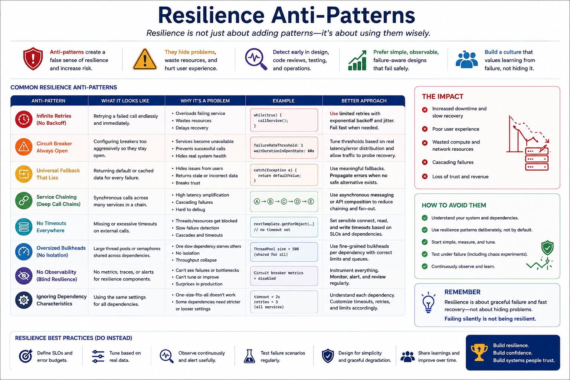
22
© 2026 by Innovation In Software Corporation
Notes:
KEY TALKING POINTS
------------------
- COMMON ANTI-PATTERNS
Group the table's rows into three families.
Retry and breaker misuse: infinite retries with no backoff hammer a failing service, and a breaker tuned too aggressively, like the example with a failure-rate threshold of 1, opens on noise and blocks healthy traffic.
Dishonest fallbacks: a universal catch that returns a default value hides outages and can serve stale or wrong data.
Structural problems: deep synchronous chains multiply latency, missing timeouts let threads block, oversized shared pools provide no isolation, and one-size settings ignore each dependency's real behaviour.
- HOW TO AVOID THEM
The remedies are habits rather than libraries.
Understand each dependency: how critical it is, its normal latency and its failure modes.
Tune settings from measured data, not copied defaults.
Test under real failure, including chaos experiments, so you see what the configuration actually does.
Instrument every resilience component, because a breaker whose state nobody can see, or a fallback that nobody counts, turns an outage into a mystery.
The Remember panel sums it up: resilience means graceful failure and fast recovery, not hiding problems.
REAL-WORLD EXAMPLES
-------------------
- A universal fallback that returns a zero or cached balance whenever the core banking call fails can show customers an incorrect figure and suppress the error alerts, so the outage is discovered through complaints instead of monitoring.
- The AWS Builders' Library discusses how retries at several layers of a call stack multiply, so a single user request can turn into many backend attempts during an outage, and recommends retrying at a single layer with backoff and jitter.
USE-CASE SCENARIO
-----------------
Review a hypothetical pull request against the capstone.
Transaction Service's AccountClient catches Exception and returns an ACTIVE account, wraps the call in a retry with ten attempts and no backoff, and the RestClient timeout has been removed because tests were slow.
Ask learners to find every row of the table in that change: universal fallback that lies, infinite-style retries, and no timeouts.
Then ask what an ops user would see with Account Service down: long hangs, duplicate-looking load on Account Service, and eventually transactions published to Kafka for accounts nobody verified.
The Lab 3 solution avoids all three.

Slide 24
MICROSERVICES PERFORMANCE FUNDAMENTALS · LATENCY, THROUGHPUT, AND RESOURCE UTILIZATION · PERFORMANCE BUDGETS
📌
COMMON PERFORMANCE BOTTLENECKS
✅
BEST PRACTICES
📌
THE THREE DIMENSIONS
• Network calls (latency, chattiness), database queries (N+1, missing indexes)
• Thread pool sizing, caching (low hit rate, stampede), serialization overhead
• Design for loose coupling, use asynchronous messaging where possible
• Cache close to the data, right-size pools, paginate, set timeouts, profile hot paths
• Latency: how fast a request is served (p50, p95, p99)
• Throughput: how much work is done per unit time (requests per second)
• Resource utilization: how efficiently CPU, memory, disk, and network are used
⚖️
TRADE-OFFS TO UNDERSTAND
📌
PERFORMANCE BUDGET FORMULA
• Lower latency may reduce throughput; higher throughput may consume more resources
• Keep headroom -- never run at 100% utilization
• Performance Budget = Target (user expectation) - Safety Margin - Variability Buffer
• Types: latency budget, throughput budget, availability budget, error budget, resource budget
KEY TAKEAWAY Performance is a feature -- optimizing end-to-end user experience matters more than tuning any single service in isolation. • Lowering latency often needs more resources; pushing throughput higher needs efficient resource usage -- optimizing one affects the others. • If the end-to-end target is 500 ms, each service in the chain gets its own slice -- and the sum must never exceed the total budget.
23
© 2026 by Innovation In Software Corporation
Notes:
TOPIC 1 OF 3: Microservices Performance Fundamentals
------------------------------------------
KEY TALKING POINTS
------------------
- COMMON PERFORMANCE BOTTLENECKS
Network calls are orders of magnitude slower than in-process calls, so chatty designs that make many small calls per request add up quickly.
N+1 queries appear when JPA lazily loads a child collection once per parent row.
Missing indexes turn lookups into full table scans.
Thread pools that are too small queue work; too large ones thrash the CPU.
Caches with low hit rates add cost without benefit, and a cache stampede happens when many requests rebuild the same expired entry at once.
Large JSON payloads cost serialization time.
- BEST PRACTICES
Loose coupling and asynchronous messaging remove waits from the request path; the capstone's Kafka hand-off to Risk Assessment Service is an example.
Cache close to the data for slow-changing reference information.
Right-size connection and thread pools from measurements.
Paginate list endpoints so one request cannot return a whole table.
Keep timeouts on every remote call.
Profile the hot paths rather than guessing, using tools such as Java Flight Recorder, because the slow part is frequently not where developers expect it.
REAL-WORLD EXAMPLES
-------------------
- A transaction history screen that loads each transaction's merchant details with a separate query is a classic N+1 problem; a single join or batch fetch can turn hundreds of queries into one.
- Banks commonly cache slow-changing reference data such as branch locations, currency codes and product catalogues, while never caching live balances beyond what policy explicitly allows.
USE-CASE SCENARIO
-----------------
Ops users report that GET /api/v1/transactions in Transaction Service slows down as test data grows.
Investigation shows the endpoint returns every transaction without pagination, and for each one the service calls Account Service to fetch account details, a chatty N+1 across the network.
The team adds pagination, returns the accountId already stored with each transaction instead of calling out, and checks that the query filters on an indexed column in PostgreSQL.
Latency drops, Account Service load falls, and the circuit breaker stops seeing timeouts caused by self-inflicted traffic.
TOPIC 2 OF 3: Latency, Throughput, and Resource Utilization
------------------------------------------
KEY TALKING POINTS
------------------
- THE THREE DIMENSIONS
Latency is time per request, and percentiles matter more than averages: p95 means 95 percent of requests are faster than that value, so p99 shows what the slowest one percent of customers feel.
An average can look healthy while those customers time out.
Throughput is completed work per unit of time.
Utilisation is how much of each resource is in use.
The three are linked, so a performance claim that quotes only one of them is incomplete.
- TRADE-OFFS TO UNDERSTAND
Batching raises throughput but makes individual requests wait, which raises latency.
Low latency often needs spare capacity sitting idle, which lowers utilisation efficiency.
As utilisation approaches 100 percent, queues grow sharply and latency climbs steeply, so a service at full CPU is already degraded.
Headroom absorbs traffic spikes, pod restarts during deployments and the extra load when one replica fails.
On OpenShift, autoscaling thresholds are set well below full utilisation for exactly this reason.
REAL-WORLD EXAMPLES
-------------------
- A card authorisation service is tuned for low, predictable p99 latency because each request has a customer waiting at a till, whereas an overnight statement generation batch is tuned for throughput because nobody waits on any single statement.
- Kafka producers expose a trade-off directly through settings such as linger.ms and batch size: waiting briefly to batch more records raises throughput at the cost of slightly higher per-record latency.
USE-CASE SCENARIO
-----------------
The Transaction Service team reports that average POST latency is fine, but ops users complain that some submissions feel stuck.
Looking at percentiles shows a healthy p50 and a much worse p99, all of it concentrated in requests where the Account Service call is slow.
Meanwhile CPU on Transaction Service pods sits close to its limit during peak hours.
The team adds a replica to restore headroom and investigates Account Service's slow lookups.
The lesson for the class: averages hid the problem, and the fix touched utilisation as much as code.
TOPIC 3 OF 3: Performance Budgets
---------------------------------
KEY TALKING POINTS
------------------
- PERFORMANCE BUDGET FORMULA
Start from what the user or business needs, then subtract a safety margin for things you cannot control and a buffer for normal variability such as garbage collection pauses and network jitter.
What remains is split across the call chain.
Each service's timeout should fit inside its slice, and retries count against the same budget.
The listed types extend the idea: throughput and resource budgets cap capacity use, and error and availability budgets, from SRE practice, define how much unreliability an objective allows before releases slow down.
REAL-WORLD EXAMPLES
-------------------
- A mobile banking home screen with a target load time might allocate fixed slices to authentication, balance lookup and recent transactions, so any team whose call exceeds its slice knows it owns the regression.
- Google's Site Reliability Engineering book popularised error budgets: if a service's objective permits a small fraction of failed requests and the team uses it up, new feature releases pause in favour of reliability work.
USE-CASE SCENARIO
-----------------
Use an illustrative target for the capstone: the business wants POST /api/v1/transactions to answer within one second.
After a safety margin and buffer, perhaps 700 ms remain.
The Account Service lookup, the PostgreSQL insert and the Kafka publish each receive a slice.
Now compare with Lab 3's RestClient read timeout of 3 seconds: a single slow Account Service call can blow the whole budget three times over.
That is acceptable for a classroom, where clarity matters, but a production team would derive a much shorter timeout from the budget and from measured p99 latency.

Slide 25
CONNECTION POOLING AND THREAD MANAGEMENT · JVM PERFORMANCE CONSIDERATIONS · HORIZONTAL VS. VERTICAL SCALING
📌
CONNECTION POOLING
✅
THREAD MANAGEMENT
📌
KEY AREAS THAT IMPACT PERFORMANCE
• Limits the number of open connections to a safe, efficient size
• Key settings: maximumPoolSize, minimumIdle, idleTimeout, connectionTimeout, maxLifetime
• Too few threads means low throughput; too many means context switching and CPU pressure
• Use bounded thread pools and tune based on the actual workload
• Memory management and garbage collection tuning prevent OutOfMemoryError and reduce pauses
• JIT compilation, thread management, and blocking I/O all shape throughput and latency
✅
GC OPTIONS
📌
HORIZONTAL SCALING (SCALE OUT)
✅
VERTICAL SCALING (SCALE UP)
• G1 (default): balanced throughput and pause times, good for large heaps
• ZGC / Shenandoah: very low pause times for latency-sensitive services
• Add more instances behind a load balancer; distributes load across many nodes
• High availability and fault tolerance, but requires stateless applications
• Add more CPU, RAM, and storage to a single node; simple, no code changes
• Hits a hardware ceiling and can require downtime to apply
KEY TAKEAWAY Creating a new database connection is expensive -- a connection pool reuses existing ones and prevents connection storms. • G1 is the sensible default for most microservices; ZGC and Shenandoah trade some throughput for very low pause times when latency is critical. • Horizontal scaling adds more instances behind a load balancer; vertical scaling adds more CPU, RAM, and storage to a single node.
24
© 2026 by Innovation In Software Corporation
Notes:
TOPIC 1 OF 3: Connection Pooling and Thread Management
------------------------------------------
KEY TALKING POINTS
------------------
- CONNECTION POOLING
Opening a database connection involves network round trips, authentication and session setup, so reusing connections saves real time.
HikariCP is Spring Boot's default pool, configured under spring.datasource.hikari with kebab-case keys such as maximum-pool-size.
maximumPoolSize caps connections, and its default is 10.
minimumIdle keeps some warm.
idleTimeout closes unused ones.
connectionTimeout is how long a request waits for a free connection before failing.
maxLifetime retires connections before the database or a firewall silently drops them.
Remember that every replica has its own pool against the same database.
- THREAD MANAGEMENT
Threads that mostly wait on I/O can be more numerous than CPU cores; CPU-bound threads cannot usefully exceed the cores available.
Beyond that point, extra threads just spend time switching and compete for memory.
Bounded pools make overload visible as rejections instead of slow collapse.
Tune from measurements of active threads and queue sizes under load.
On Java 21 with Spring Boot 3.2 or later, virtual threads, enabled with spring.threads.virtual.enabled, change the thread picture for blocking I/O, but connection pools still cap real concurrency.
REAL-WORLD EXAMPLES
-------------------
- A bank that scales a service from a handful of pods to many during a peak can exhaust its database's connection limit if each pod keeps a large pool, so total pool size across replicas must be planned against the database maximum.
- Connection storms after an outage are common: when a database restarts, every service reconnects at once.
Bounded pools with sensible connection timeouts turn that surge into short queues instead of a second outage.
USE-CASE SCENARIO
-----------------
Under load testing, Transaction Service starts returning errors that mention a connection not being available within the timeout, while PostgreSQL CPU sits low.
The Hikari pool is at its default of 10 connections, and each POST /api/v1/transactions holds its connection for the entire request, including the Account Service call of up to 3 seconds.
Threads are waiting on connections held idle during a network call.
The fix is not simply a bigger pool: the team keeps the remote call outside the database transaction so connections are held only for the insert, then re-measures.
TOPIC 2 OF 3: JVM Performance Considerations
------------------------------------------
KEY TALKING POINTS
------------------
- KEY AREAS THAT IMPACT PERFORMANCE
Heap sizing decides how often garbage collection runs and whether the service survives spikes.
In containers the JVM reads the memory limit, and by default the maximum heap is a quarter of it, so teams usually set MaxRAMPercentage explicitly.
The JIT compiler optimises hot code while the service runs, which is why a freshly started pod is slower at first and why load tests need a warm-up period.
Blocking I/O ties up threads, which links back to pool sizing and timeouts.
- GC OPTIONS
G1 is the default collector on server-class machines and balances throughput with pause times.
One caveat for OpenShift: if a container gets fewer than two CPUs or a small memory limit, the JVM may choose the Serial collector instead, so specify the collector explicitly.
ZGC and Shenandoah do most work concurrently and keep pauses very short at some cost in CPU and throughput.
On Java 21, generational ZGC is enabled with UseZGC plus ZGenerational, and it became ZGC's default mode in later releases.
REAL-WORLD EXAMPLES
-------------------
- Latency-sensitive services such as card authorisation or market data distribution are typical candidates for low-pause collectors, because a long garbage collection pause directly becomes a slow or timed-out customer transaction.
- Teams moving Spring Boot services from virtual machines to OpenShift frequently discover the service was sized for a large host; with a small container memory limit and default heap percentage, the same code hits OutOfMemoryError until heap settings are revisited.
USE-CASE SCENARIO
-----------------
When the capstone moves to OpenShift in Labs 4 and 5, Transaction Service runs with a modest CPU and memory limit.
Picture a load test where p99 latency shows periodic spikes and the logs reveal that the JVM chose the Serial collector because the pod had a single CPU.
Pauses line up with the spikes, and some Account Service calls then exceed their timeout, nudging the circuit breaker.
The team raises the CPU request, sets G1 explicitly and a MaxRAMPercentage suited to the container, reruns the test after warm-up, and the spikes flatten.
TOPIC 3 OF 3: Horizontal vs. Vertical Scaling
------------------------------------------
KEY TALKING POINTS
------------------
- HORIZONTAL SCALING (SCALE OUT)
More replicas share traffic, and losing one replica removes only part of capacity, which is why OpenShift deployments normally run at least two.
On OpenShift, a Service load-balances across pods and a HorizontalPodAutoscaler can add replicas based on CPU or other metrics.
The requirement is statelessness: session data, caches and in-progress work must live in shared stores such as PostgreSQL or Kafka, not in pod memory.
Also remember downstream limits: more replicas mean more database connections, and extra Kafka consumers beyond the partition count sit idle.
- VERTICAL SCALING (SCALE UP)
Giving a service more CPU and memory is the quickest fix and suits workloads that cannot easily be split, such as a single database primary.
It needs no code change.
The limits are the size of the largest available node and the fact that a single instance is still a single point of failure.
In Kubernetes and OpenShift, changing a pod's resource requests usually means the pod is recreated, which is why such changes roll out gradually rather than in place.
REAL-WORLD EXAMPLES
-------------------
- Stateless API tiers in digital banking, such as login, balance and transfer APIs, are commonly scaled out ahead of known peaks like payday or tax deadlines, while the core ledger database is typically scaled up and protected with replicas.
- Kafka consumer groups scale horizontally only up to the number of partitions: a risk-scoring consumer group with more members than partitions leaves the extra members idle, so partition count must be planned with scale-out in mind.
USE-CASE SCENARIO
-----------------
In Lab 5 the capstone runs on OpenShift.
Suppose transaction volume triples during a demo load test.
Transaction Service is stateless, because transactions live in PostgreSQL and events in Kafka, so the team scales it out to more replicas.
Account Service scales out too, since every transaction triggers an account lookup.
Risk Assessment Service, however, stops gaining throughput beyond the number of partitions on transactions.submitted.
Meanwhile the shared PostgreSQL instance reaches its connection limit because each new replica brought its own Hikari pool.
The class sees that scaling one tier moves the bottleneck to the next.

Slide 26
BACKPRESSURE AND FLOW CONTROL · LOAD TESTING MICROSERVICES
📌
HOW BACKPRESSURE WORKS
✅
FLOW CONTROL TECHNIQUES
• Signals flow upstream to slow down the producer when the consumer or queue is overwhelmed
• Prevents buffer overflow and out-of-memory errors, keeping the system stable under load
• Rate limiting, bounded queues, credit-based flow control, reactive streams
📌
KEY METRICS TO MONITOR
✅
COMMON TOOLS
• Response time (avg, p95, p99), throughput, and error rate
• CPU/memory utilization, queue depth/lag, active connections and threads
• k6, JMeter, Gatling, Locust, Artillery, NBomber
KEY TAKEAWAY Without backpressure, unbounded queues grow until they exhaust memory; with it, the whole pipeline degrades gracefully instead of crashing. • Define objectives, plan, design, execute, analyze, then optimize and retest -- a six-step process turns load testing into a repeatable discipline.
25
© 2026 by Innovation In Software Corporation
Notes:
TOPIC 1 OF 2: Backpressure and Flow Control
------------------------------------------
KEY TALKING POINTS
------------------
- HOW BACKPRESSURE WORKS
Whenever a producer can generate work faster than a consumer can finish it, the difference piles up somewhere.
Without backpressure it piles up in memory, in queues or thread pools, until the process slows and eventually crashes.
Backpressure makes the consumer's limit visible to the producer, which then slows, pauses, rejects or buffers to disk.
The result is a system that stays alive at its real capacity rather than accepting everything and failing all of it.
- FLOW CONTROL TECHNIQUES
Rate limiting caps how fast work enters.
Bounded queues have a fixed size, so when full the producer must wait or get rejected instead of growing memory without limit.
Credit-based flow control lets the receiver grant permission for a number of messages, as HTTP/2 does with its flow-control windows.
Reactive Streams, used by Project Reactor in Spring WebFlux, formalise this with a subscriber requesting a number of items from the publisher.
Kafka achieves a similar effect because consumers pull records at their own pace.
REAL-WORLD EXAMPLES
-------------------
- In card payment processing, messages stored durably in a broker let a slow downstream fraud or ledger consumer fall behind temporarily without losing transactions; operations teams watch consumer lag rather than seeing memory errors.
- An upload service for bulk payment files that reads with bounded in-memory buffers can process very large files steadily, whereas one that reads the whole file into memory can crash on the first unusually large upload.
USE-CASE SCENARIO
-----------------
In the capstone, Transaction Service publishes to transactions.submitted and Risk Assessment Service consumes it.
If a burst of transactions arrives while risk scoring is slow, Kafka stores the backlog durably, and the consumer pulls only as many records per poll as it can process.
That is backpressure by design: Risk Assessment Service never receives more than it asks for.
The visible symptom is consumer lag, which the team monitors.
Contrast this with an alternative where Transaction Service calls Risk Assessment synchronously with an unbounded in-memory queue in front: the same burst would exhaust memory.
TOPIC 2 OF 2: Load Testing Microservices
----------------------------------------
KEY TALKING POINTS
------------------
- KEY METRICS TO MONITOR
Measure both what the client sees and what the service is doing.
Response time percentiles, throughput and error rate tell you whether the test met its objective.
Utilisation, queue depth or Kafka consumer lag, active connections and thread counts tell you why it did or did not, and where the bottleneck is.
Watch them together over time: rising p99 alongside a flat connection pool at its maximum points to pool exhaustion, while rising lag with low CPU points to a slow downstream.
- COMMON TOOLS
All six generate load, but they suit different teams.
k6 uses JavaScript test scripts and fits developer workflows and CI.
Apache JMeter is a long-established Java tool with a graphical designer.
Gatling uses a code-based DSL with Java, Kotlin and Scala options and produces detailed HTML reports.
Locust writes user behaviour in Python.
Artillery is Node.js-based with YAML scenarios.
NBomber targets .NET teams.
For a Java shop, Gatling or JMeter are natural choices, and k6 is popular for pipeline smoke tests.
REAL-WORLD EXAMPLES
-------------------
- Retail banks typically load test online and mobile banking ahead of predictable peaks such as payday, holiday shopping periods and tax deadlines, replaying realistic mixes of logins, balance checks and transfers rather than hammering a single endpoint.
- Teams running OpenShift Pipelines can add a short load test stage after deployment to a test namespace, failing the pipeline if p95 latency or error rate crosses an agreed threshold before promotion.
USE-CASE SCENARIO
-----------------
Before the capstone demo on Day 5, the team sets an objective: Transaction Service must handle a defined rate of POST /api/v1/transactions with p95 under an agreed target and no platform errors.
They write a Gatling scenario that authenticates with an ops token, submits transactions for ACTIVE accounts and reads them back.
During the run they watch Transaction Service latency, Hikari active connections, Account Service p99 and consumer lag on transactions.submitted.
Lag grows steadily, revealing Risk Assessment Service as the bottleneck.
They optimise, rerun the same script and compare results.

Slide 27
STRESS, SPIKE, SOAK, AND SCALABILITY TESTING · SERVICE-LEVEL INDICATORS · SERVICE-LEVEL OBJECTIVES
📌
THE FOUR TEST TYPES
📌 COMMON SLIS FOR MICROSERVICES
• Stress: push beyond capacity until failure occurs, to find the breaking point
• Spike: sudden, extreme load increases, to validate graceful handling
• Soak (endurance): sustained load for 24-72+ hours, to catch memory/resource leaks
• Scalability: increase resources and measure throughput improvement
SLI | MEASURED AS
Latency | p50, p95, p99 (ms)
Availability | % of successful requests
Error rate | % of requests resulting in errors
Saturation | CPU %, memory %, queue size
Traffic/Throughput | Requests per second (RPS)
📌
KEY CHARACTERISTICS OF GOOD SLOs
🏦
BANKING EXAMPLE
• User-focused, measurable, time-bound, challenging but achievable
• Limited in number -- a few critical objectives per service, not dozens
• Payment Service latency (p95): under 300 ms over a 7-day window
• Order Service availability: 99.9% over a 30-day window
KEY TAKEAWAY Stress finds the breaking point, spike checks sudden surges, soak reveals slow leaks, and scalability testing measures how well growth is absorbed. • An SLI is a quantitative measurement from the user's point of view -- the raw data every SLO and error budget is built on top of. • 99.9% availability over 30 days means: we expect the service to be available 99.9% of the time each month -- a clear, actionable commitment.
26
© 2026 by Innovation In Software Corporation
Notes:
TOPIC 1 OF 3: Stress, Spike, Soak, and Scalability Testing
------------------------------------------
KEY TALKING POINTS
------------------
- THE FOUR TEST TYPES
Stress testing ramps load until errors or latency become unacceptable, so you learn where and how the service fails, ideally gracefully with 503s rather than crashes.
Spike testing jumps from normal to extreme load in seconds to check autoscaling, connection pools, and circuit breakers.
Soak testing runs realistic load for a long period, often 24 hours or more, to expose memory leaks, connection leaks, and log or disk growth that short tests never show.
Scalability testing adds pods or CPU and checks whether throughput rises proportionally or hits a shared bottleneck such as the database.
REAL-WORLD EXAMPLES
-------------------
- Retail banks see predictable spikes on payday mornings and at the start of the month when salaries land and bill payments run; spike tests model that surge against login, balance, and transfer APIs before it happens for real.
- A soak test on a card-authorisation service can reveal a slow connection-pool leak that only exhausts the pool after many hours, which would otherwise appear in production as a mysterious overnight outage.
USE-CASE SCENARIO
-----------------
Before the capstone goes live, the team scales Transaction Service to three pods and runs a scalability test, expecting three times the throughput.
Throughput barely doubles.
The trace shows every POST waits on the Account Service GET and on PostgreSQL inserts, so the bottleneck is downstream, not CPU in Transaction Service.
A spike test then confirms that when Account Service slows, the circuit breaker opens and callers get fast 503s instead of hanging threads.
Finally a long soak test at normal load shows memory flat, so there is no leak in the Kafka publisher.
Each test answered a different question.
TOPIC 2 OF 3: Service-Level Indicators
--------------------------------------
KEY TALKING POINTS
------------------
- COMMON SLIS FOR MICROSERVICES
Latency uses percentiles because averages hide the slow tail: p95 means 95 percent of requests were faster than that value, and p99 shows what the unluckiest one percent experience.
Availability is successful requests divided by valid requests.
Error rate should separate platform errors, such as 5xx and timeouts, from correct business rejections like a 409 for a frozen account.
Saturation shows how close CPU, memory, thread pools, or Kafka consumer lag are to their limits.
Traffic gives context: an error rate means little without request volume.
Latency, traffic, errors, and saturation are the four golden signals; Micrometer and Actuator expose them in Spring Boot.
REAL-WORLD EXAMPLES
-------------------
- A card-authorisation platform typically watches p99 latency closely, because a small percentage of slow authorisations at the payment terminal is visible to customers even when the average looks healthy.
- For a statement-download service, saturation of the PDF rendering worker queue is often the earliest warning; latency only rises after the queue is already backing up.
USE-CASE SCENARIO
-----------------
The capstone team defines SLIs for POST /api/v1/transactions.
Latency is the p95 and p99 of the HTTP server request timer that Micrometer records.
Availability counts responses that are not 5xx.
They deliberately exclude 409 ACCOUNT_NOT_ELIGIBLE from the error SLI, because rejecting a transaction on a frozen account is the correct outcome, but they do count 503 ACCOUNT_SERVICE_UNAVAILABLE, because the customer could not transact.
Saturation is Kafka producer queue time and database connection pool usage.
With those definitions agreed, the next block can set targets.
TOPIC 3 OF 3: Service-Level Objectives
--------------------------------------
KEY TALKING POINTS
------------------
- KEY CHARACTERISTICS OF GOOD SLOs
User-focused means the objective reflects what a customer or calling service feels, such as transfer latency, not internal CPU.
Measurable means an existing metric can prove it.
Time-bound means a rolling window, because 99.9 percent over a day and over a month allow very different outages.
Challenging but achievable avoids both complacency and permanent failure.
Keeping only a few per service keeps alerts and reviews meaningful; dozens of SLOs mean nobody knows which one matters.
- BANKING EXAMPLE
Read each example as SLI, target, window.
Payment Service p95 latency under 300 ms over seven days is a latency objective for a customer-facing money-movement path.
The second example uses an Order Service name, which comes from generic e-commerce material; in this course say Account Service or Transaction Service instead, for example Transaction Service availability of 99.9 percent over 30 days.
A 99.9 percent monthly objective allows roughly 43 minutes of unavailability, which leads straight into error budgets.
REAL-WORLD EXAMPLES
-------------------
- Many banks set stricter objectives for payment authorisation than for rewards or marketing-offer lookups, because a failed payment is a customer and regulatory issue while a missing points balance is an inconvenience.
- Cloud providers publish availability commitments per service, which teams use to check whether their own internal objectives are even achievable when they depend on those platforms.
USE-CASE SCENARIO
-----------------
The capstone team proposes two SLOs for Transaction Service: 99.9 percent of POST /api/v1/transactions requests succeed without a 5xx over a rolling 30 days, and p95 latency stays under 300 ms over 7 days.
Someone suggests a third for CPU below 60 percent; the group rejects it because customers do not feel CPU.
They then realise the latency objective depends on Account Service, since every POST calls it with a 2 second connect and 3 second read timeout.
That dependency forces them to agree a matching objective with the Account Service team, which is exactly how SLOs shape service contracts.

Slide 28
SERVICE-LEVEL AGREEMENTS · ERROR BUDGETS · CAPACITY PLANNING
📌
KEY COMPONENTS OF AN SLA
🏦
EXAMPLE SLA (ORDER SERVICE)
📌
HOW IT WORKS
• Service scope, service-level objectives, measurement methods
• Responsibilities of provider and consumer, and remediation actions if targets are missed
• 99.9% monthly uptime, P95 response time under 300 ms, error rate under 0.1%
• Incident response within 15 minutes, resolution within 4 hours
1. Define an SLO, e.g. 99.9% availability over a month
2. Calculate the error budget: 0.1% of the time is allowed for errors
3. Monitor burn rate in real time
4. Use the budget to guide release velocity and reliability investment
✅
CONSEQUENCES OF BUDGET STATUS
📌
KEY CAPACITY DRIVERS
✅
CAPACITY HEADROOM GUIDELINES
• Healthy: safe to release new features and take more risk
• Exhausted: freeze new features, focus on reliability and remediation
• User demand, business growth, seasonality, data growth
• Performance goals and resilience needs (HA, failover, disaster recovery)
• Low risk (stable demand): 10-20% headroom
• Mission critical: 50-100%+ headroom
KEY TAKEAWAY Service scope, SLOs, measurement methods, responsibilities, and remediation together turn a reliability goal into an enforceable commitment. • A 99.9% availability SLO over 30 days allows 43.2 minutes of downtime -- spend it wisely, and use burn rate to guide release risk. • Understand demand, collect metrics, forecast, decide, and implement -- a five-step process keeps infrastructure sized to real, not guessed, need.
27
© 2026 by Innovation In Software Corporation
Notes:
TOPIC 1 OF 3: Service-Level Agreements
--------------------------------------
KEY TALKING POINTS
------------------
- KEY COMPONENTS OF AN SLA
An SLA is the contract that turns a reliability hope into something both sides can measure and enforce.
Scope says which APIs and hours are covered.
SLOs name the targets, such as availability or latency.
Measurement methods prevent arguments about whose dashboard is right.
Responsibilities split work between the provider who runs the service and the consumer who retries and reports.
Remediation is what happens when a target is missed: credits, incident response, or a freeze on risky releases.
Without those pieces an SLO is only a slogan.
- EXAMPLE SLA (ORDER SERVICE)
Treat each figure as a decision, not decoration.
Monthly availability of 99.9 percent leaves about 43 minutes of allowed downtime in a 30-day month.
A P95 under 300 milliseconds means most callers feel the API as instant while a tail of slower calls is still allowed.
An error-rate cap should count platform faults, not business declines such as insufficient funds.
Response and resolution clocks turn an outage into a managed incident.
The Order Service here stands in for any money-moving API, including Transaction Service on port 8082.
REAL-WORLD EXAMPLES
-------------------
- A card network and an issuing bank sign an SLA on authorisation availability and P95 latency.
If the issuer misses the target, the network can route traffic away or apply contractual remedies.
Both sides agree in advance how availability is measured so a weekend maintenance window is not argued about after the fact.
- An enterprise IT team that exposes an internal payments API to a retail-banking mobile channel publishes the same style of commitment: which endpoints are in scope, how latency is sampled, who pages whom, and what happens if the monthly error budget is burned.
USE-CASE SCENARIO
-----------------
Before the AI-Assisted Banking Transaction Risk Platform leaves a pilot, operations asks Account Service on port 8081 and Transaction Service on port 8082 for written targets.
Account lookup availability and Transaction create error rate become SLOs.
The SLA also says how they are measured from Actuator and logs, who owns the pager, and that a missed target pauses risky releases.
Risk Assessment Service arrives on Day 5 and will inherit the same habit: a model timeout is a platform fault, not a silent approve.
Lab 3 already shows the honest failure that belongs in that contract: 503 ACCOUNT_SERVICE_UNAVAILABLE, never a fake ACTIVE account.
TOPIC 2 OF 3: Error Budgets
---------------------------
KEY TALKING POINTS
------------------
- HOW IT WORKS
An error budget is the downtime or error volume an SLO still allows.
A 99.9 percent monthly availability target leaves 0.1 percent, about 43 minutes, to spend on incidents, experiments, and releases.
Burn rate is how fast that allowance is being used.
A short outage that burns a week of budget in an hour is a different decision from a slow drip.
Teams watch the remaining budget the way they watch cash: it funds change until it runs out, then reliability work takes priority over new features.
- CONSEQUENCES OF BUDGET STATUS
A healthy budget is permission to ship.
Feature work, schema changes, and dependency upgrades are acceptable risk while there is room left.
An exhausted budget is a policy, not a mood: freeze non-essential releases, fix the causes of burn, and restore headroom before taking more risk.
That rule prevents the common failure mode where a shaky service keeps shipping because a date was promised.
For a banking API, shipping into an empty budget is how a small defect becomes a customer-visible money incident.
REAL-WORLD EXAMPLES
-------------------
- A retail-banking payments team with a monthly availability SLO treats a multi-hour core-banking outage as budget spent.
They postpone a non-critical statement-redesign release and spend the next sprint on timeout and failover work instead of new screens.
- SRE practice at firms such as Google popularised error budgets so product and reliability teams share one number.
Banking platform teams use the same idea: remaining budget is the conversation starter for whether a Friday release is wise.
USE-CASE SCENARIO
-----------------
Two weeks into the month, Account Service on port 8081 has already used most of its 43-minute budget after a bad Flyway migration and a slow PostgreSQL failover.
Transaction Service on port 8082 depends on that lookup for every POST.
Product still wants a new transaction note field this week.
The error-budget rule says no: freeze the feature, keep the Resilience4j breaker and the 503 ACCOUNT_SERVICE_UNAVAILABLE fallback as the honest path, and restore reliability before adding code.
Risk Assessment Service on Day 5 will need a stable event stream; burning the rest of the budget on a cosmetic change would put that work at risk.
TOPIC 3 OF 3: Capacity Planning
-------------------------------
KEY TALKING POINTS
------------------
- KEY CAPACITY DRIVERS
Capacity is not a guess at CPU.
Demand, growth, seasonality, and data volume tell you how many requests and how much storage you will see.
Payday login spikes, tax-season transfers, and overnight batch jobs are different shapes of load.
Performance goals such as P95 latency set the ceiling you must stay under.
Resilience needs such as a standby replica or a second availability zone add capacity you hope never to use.
Plan from measured Actuator and Micrometer trends, then decide, then implement.
Guessing box size is how teams either waste cluster quota or run hot.
- CAPACITY HEADROOM GUIDELINES
Headroom is unused capacity kept on purpose so a spike does not become an outage.
Stable internal tools can live closer to the limit, often in the 10 to 20 percent band.
Money-moving and login APIs need more, commonly 50 to 100 percent or greater, because a failed transfer is worse than an idle pod.
Headroom is not only extra replicas.
It is connection-pool slack, Kafka consumer lag room, and disk for Flyway-managed PostgreSQL growth.
On OpenShift that usually means a request and limit that leave the node able to absorb a rolling deploy plus a traffic burst.
REAL-WORLD EXAMPLES
-------------------
- Retail banks staff extra authorisation capacity around Black Friday and the first of the month because card traffic is seasonal.
The extra pods sit idle most weeks and earn their keep on those peaks.
- An enterprise payroll API is sized for the last two days of the month, not the daily average.
Teams that sized to the average discovered the hard way that month-end batch and interactive users competed for the same connection pool.
USE-CASE SCENARIO
-----------------
The platform team sizes Account Service on port 8081 and Transaction Service on port 8082 from Lab 2 and Lab 3 traffic, not from a slide.
Account lookups are chatty and must stay fast; Transaction creates are fewer but each one calls Account, writes PostgreSQL, and publishes to Kafka.
They leave headroom for a rolling OpenShift deploy and for the Day 5 Risk Assessment consumer that will reread transactions.submitted.
If Account Service saturates, the Resilience4j breaker opens and callers see 503 ACCOUNT_SERVICE_UNAVAILABLE.
Capacity planning is how they keep that breaker closed on payday instead of treating it as a normal operating mode.

Slide 29
PERFORMANCE TESTING IN CI-CD
A quality gate with pass/fail thresholds on response time, throughput, and error rate turns performance into a release blocker, not an afterthought.
📌
PERFORMANCE TESTING IN THE CI/CD PIPELINE
✅
BEST PRACTICES
• Code commit -> build -> static analysis -> integration tests -> performance tests -> quality gate
• Quality gate evaluates metrics against thresholds before promoting to staging or production
• Automate performance tests in every pipeline run; fail the build when thresholds are breached
• Track performance trends over time, not just pass/fail on a single run
KEY TAKEAWAY A quality gate with pass/fail thresholds on response time, throughput, and error rate turns performance into a release blocker, not an afterthought.
28
© 2026 by Innovation In Software Corporation
Notes:
KEY TALKING POINTS
------------------
- PERFORMANCE TESTING IN THE CI/CD PIPELINE
A performance test that runs once before go-live is a project, not a control.
Putting it after integration tests and before promotion means a latency or error-rate regression blocks the same way a failed unit test does.
The quality gate compares measured response time, throughput, and error rate with agreed thresholds.
Staging or production does not see the build if the gate fails.
On this course the Day 3 habit is mvn test; Day 4 adds an OpenShift Pipelines run.
The idea is the same: performance is a release blocker, not a ticket written after customers complain.
- BEST PRACTICES
Automate the test so it is not optional, and fail the pipeline when a threshold is crossed.
A yellow warning that nobody owns will be ignored.
Trends matter as much as a single pass.
A P95 that creeps from 80 to 250 milliseconds across five builds is a regression even if each run still sits under a 300 millisecond cap.
Store the history next to the build so a reviewer can see the slope.
Keep the suite short enough for every commit, and reserve heavier soak tests for nightly or pre-release runs.
REAL-WORLD EXAMPLES
-------------------
- A mobile-banking balance API added a new join and still passed functional tests.
A pipeline gate that checks P95 against the previous week's baseline failed the build, and the join was rewritten before any branch customer saw a slow refresh.
- Enterprise IT teams often run a short JMeter or k6 smoke in CI and a longer load profile on a schedule.
The smoke catches accidental N-plus-one queries; the scheduled run catches saturation that a two-minute job cannot.
USE-CASE SCENARIO
-----------------
A developer adds logging to AccountClient.requireActiveAccount and accidentally logs the full response body on every call.
Functional Lab 3 tests still pass: scopes work, the Resilience4j breaker still opens, and the fallback still returns 503 ACCOUNT_SERVICE_UNAVAILABLE.
A pipeline performance gate on Transaction Service port 8082 shows P95 create latency climbing because each POST now waits on heavier logging while calling Account Service on port 8081.
The build fails, the log line is removed, and the Day 5 Risk Assessment work is not delayed by a production slowness incident that functional tests could not see.

Slide 30
EXERCISE 3.1 — CONFIGURE TIMEOUT AND CIRCUIT BREAKER
Module 6 checkpoint A — Resilience4j on Account dependency.
🎯
OBJECTIVE
📝
DO THIS
✅
EXPECTED RESULT
• Resilience4j on Account dependency
• 10 min · code warmup checkpoint
• Worksheet: curriculum/day-03/exercises/exercise-3.1-timeout-circuit-breaker.md
1. Find the RestClient timeouts (connect / read) in the Lab 3 Transaction starter
2. Circuit breaker opens after repeated Account failures; later calls fail fast
3. Safe fallback: POST /api/v1/transactions returns 503 ACCOUNT_SERVICE_UNAVAILABLE — no Kafka event
4. Bulkhead and rate limiting stay conceptual — do not install extra libraries for them
• You can state the fallback rule: never invent a successful financial outcome.
• Lab 3 wraps AccountClient.requireActiveAccount. Fallback is 503, never a fake ACTIVE account.
KEY TAKEAWAY You can state the fallback rule: never invent a successful financial outcome.
29
© 2026 by Innovation In Software Corporation
Notes:
KEY TALKING POINTS
------------------
- OBJECTIVE
This is a ten-minute Module 6 checkpoint, not a new service.
Participants find the resilience already sketched in the Lab 3 Transaction starter and can state what happens when Account Service on port 8081 fails.
The library is Resilience4j.
The dependency is the synchronous account lookup used before a transaction is saved.
The worksheet is the Day 3 timeout and circuit-breaker exercise.
Bulkheads and rate limiting stay on the whiteboard.
Nobody installs extra libraries for them in this checkpoint.
- DO THIS
First locate the RestClient connect and read timeouts on the Account call; the starter uses a short connect timeout and a short read timeout so a hung pod cannot hold a request thread forever.
Then follow the circuit breaker: after repeated Account failures it opens and later calls fail fast instead of waiting on the same dead dependency.
The safe fallback for POST /api/v1/transactions is 503 ACCOUNT_SERVICE_UNAVAILABLE and no Kafka event.
That is the business rule, not a library default.
Leave bulkhead and rate-limit libraries out of the pom.
- EXPECTED RESULT
A participant can say the fallback rule in one sentence: never invent a successful financial outcome.
Lab 3 wraps AccountClient.requireActiveAccount.
When the breaker is open or the call fails, the API returns 503 ACCOUNT_SERVICE_UNAVAILABLE.
It does not return a synthetic account with status ACTIVE, does not persist a RECEIVED row, and does not publish TransactionSubmitted.
If someone cannot say that sentence without looking at the slide, the checkpoint is not done yet.
REAL-WORLD EXAMPLES
-------------------
- A bill-pay service that cannot reach the source-account host returns a try-again error to the customer channel.
It does not debit a guessed balance and reconcile later.
Operations would rather see a spike of 503s than a pile of unmatched postings.
- Enterprise batch jobs that post internal transfers typically fail the whole unit of work when the account master is unreachable, then retry the batch, rather than marking items paid from a cached status.
USE-CASE SCENARIO
-----------------
Pairs open the Lab 3 Transaction starter and trace one POST.
The caller will later send a Bearer token, but this checkpoint is about failure, not scopes.
Transaction Service on port 8082 calls Account Service on port 8081 to require an ACTIVE account.
They find the RestClient timeouts, then the Resilience4j breaker around requireActiveAccount.
They write on the worksheet: four failures open the circuit; the next call fails fast; the API returns 503 ACCOUNT_SERVICE_UNAVAILABLE; no event goes to Kafka.
They also write what they must never do: construct an AccountResponse with status ACTIVE.
That sentence is the ticket into the rest of Lab 3 and into Day 5, when Risk Assessment must not score a transaction that was never validated.

